Slide 1
2023 KWKG Adjudicated Show
For the video of the show, check out
https://youtu.be/BxXbTy9qYzM

Slide 2
Category 1: Head & Neck
Appetizers (Firsts)

Slide 3
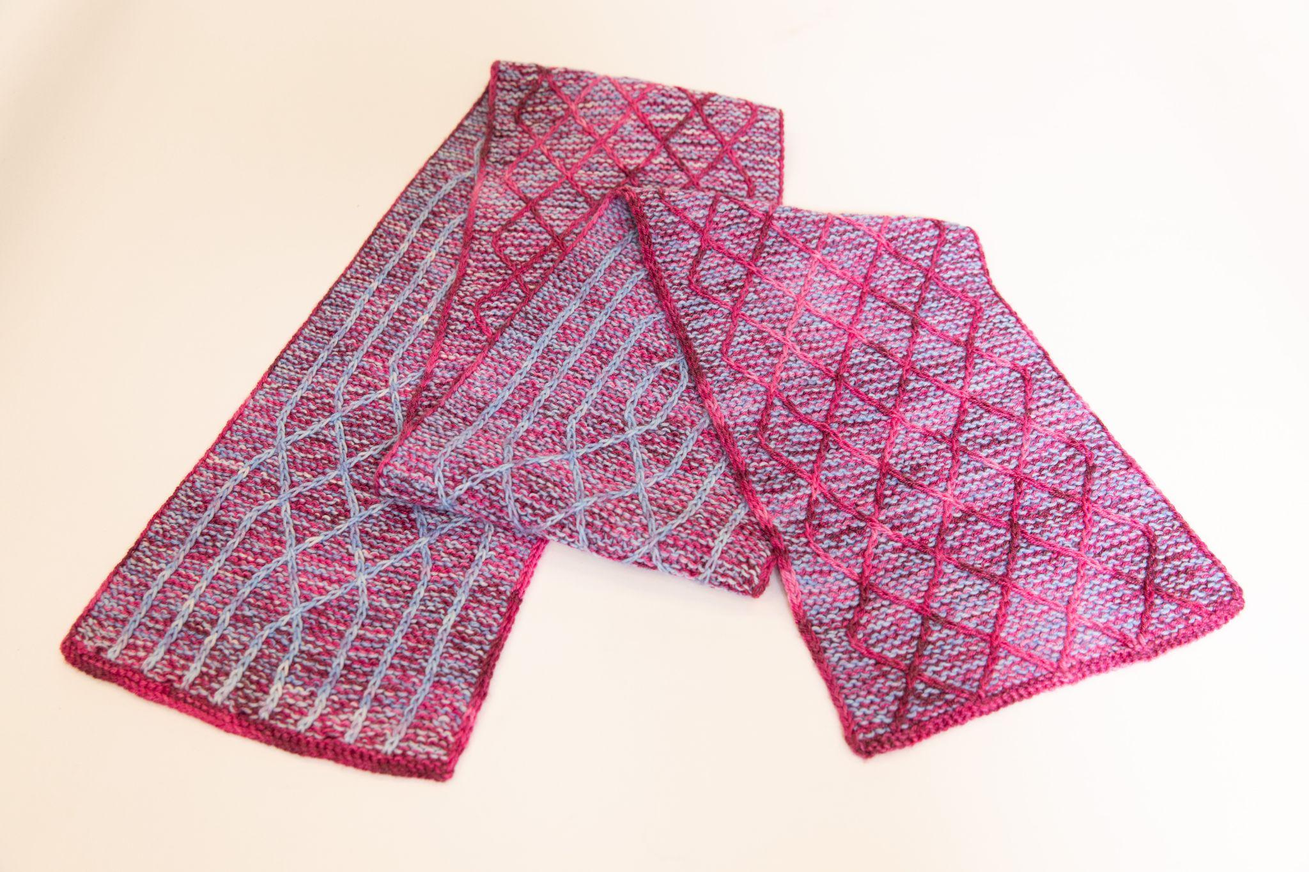
Fraternal Forever Scarf by Lynn Philips
First Place
Yarn: Les Laines Coco Bas du Fleuve and Miss Babs Train Case
https://ravelry.com/projects/needler60/fraternal-forever-scarf

Slide 4
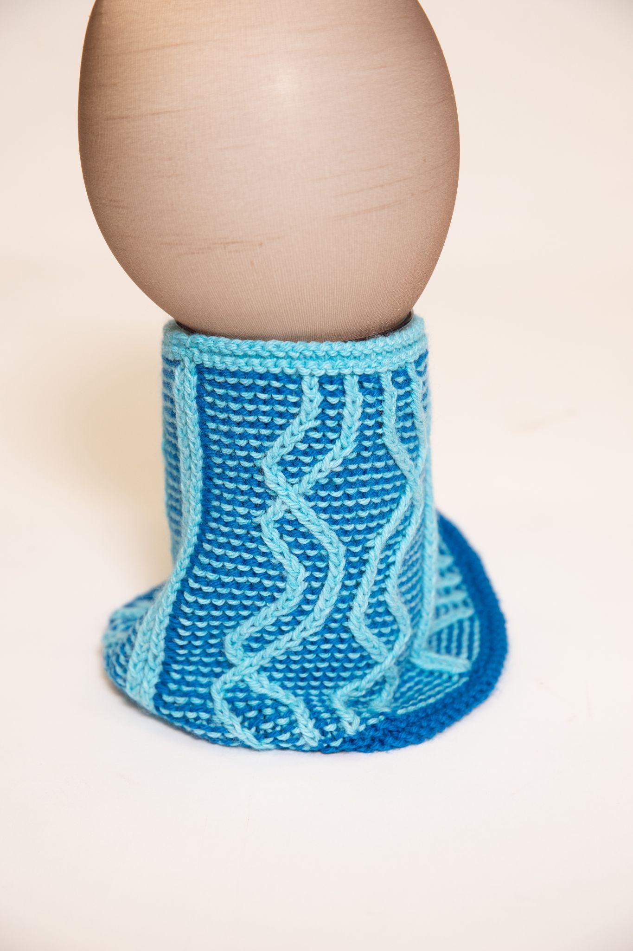
Follow the Leader Cowl by Laura Weeks
Second Place
Yarn: Berroco Vintage
https://ravelry.com/projects/purplemathmom/kw-fusion-cowl

Slide 5
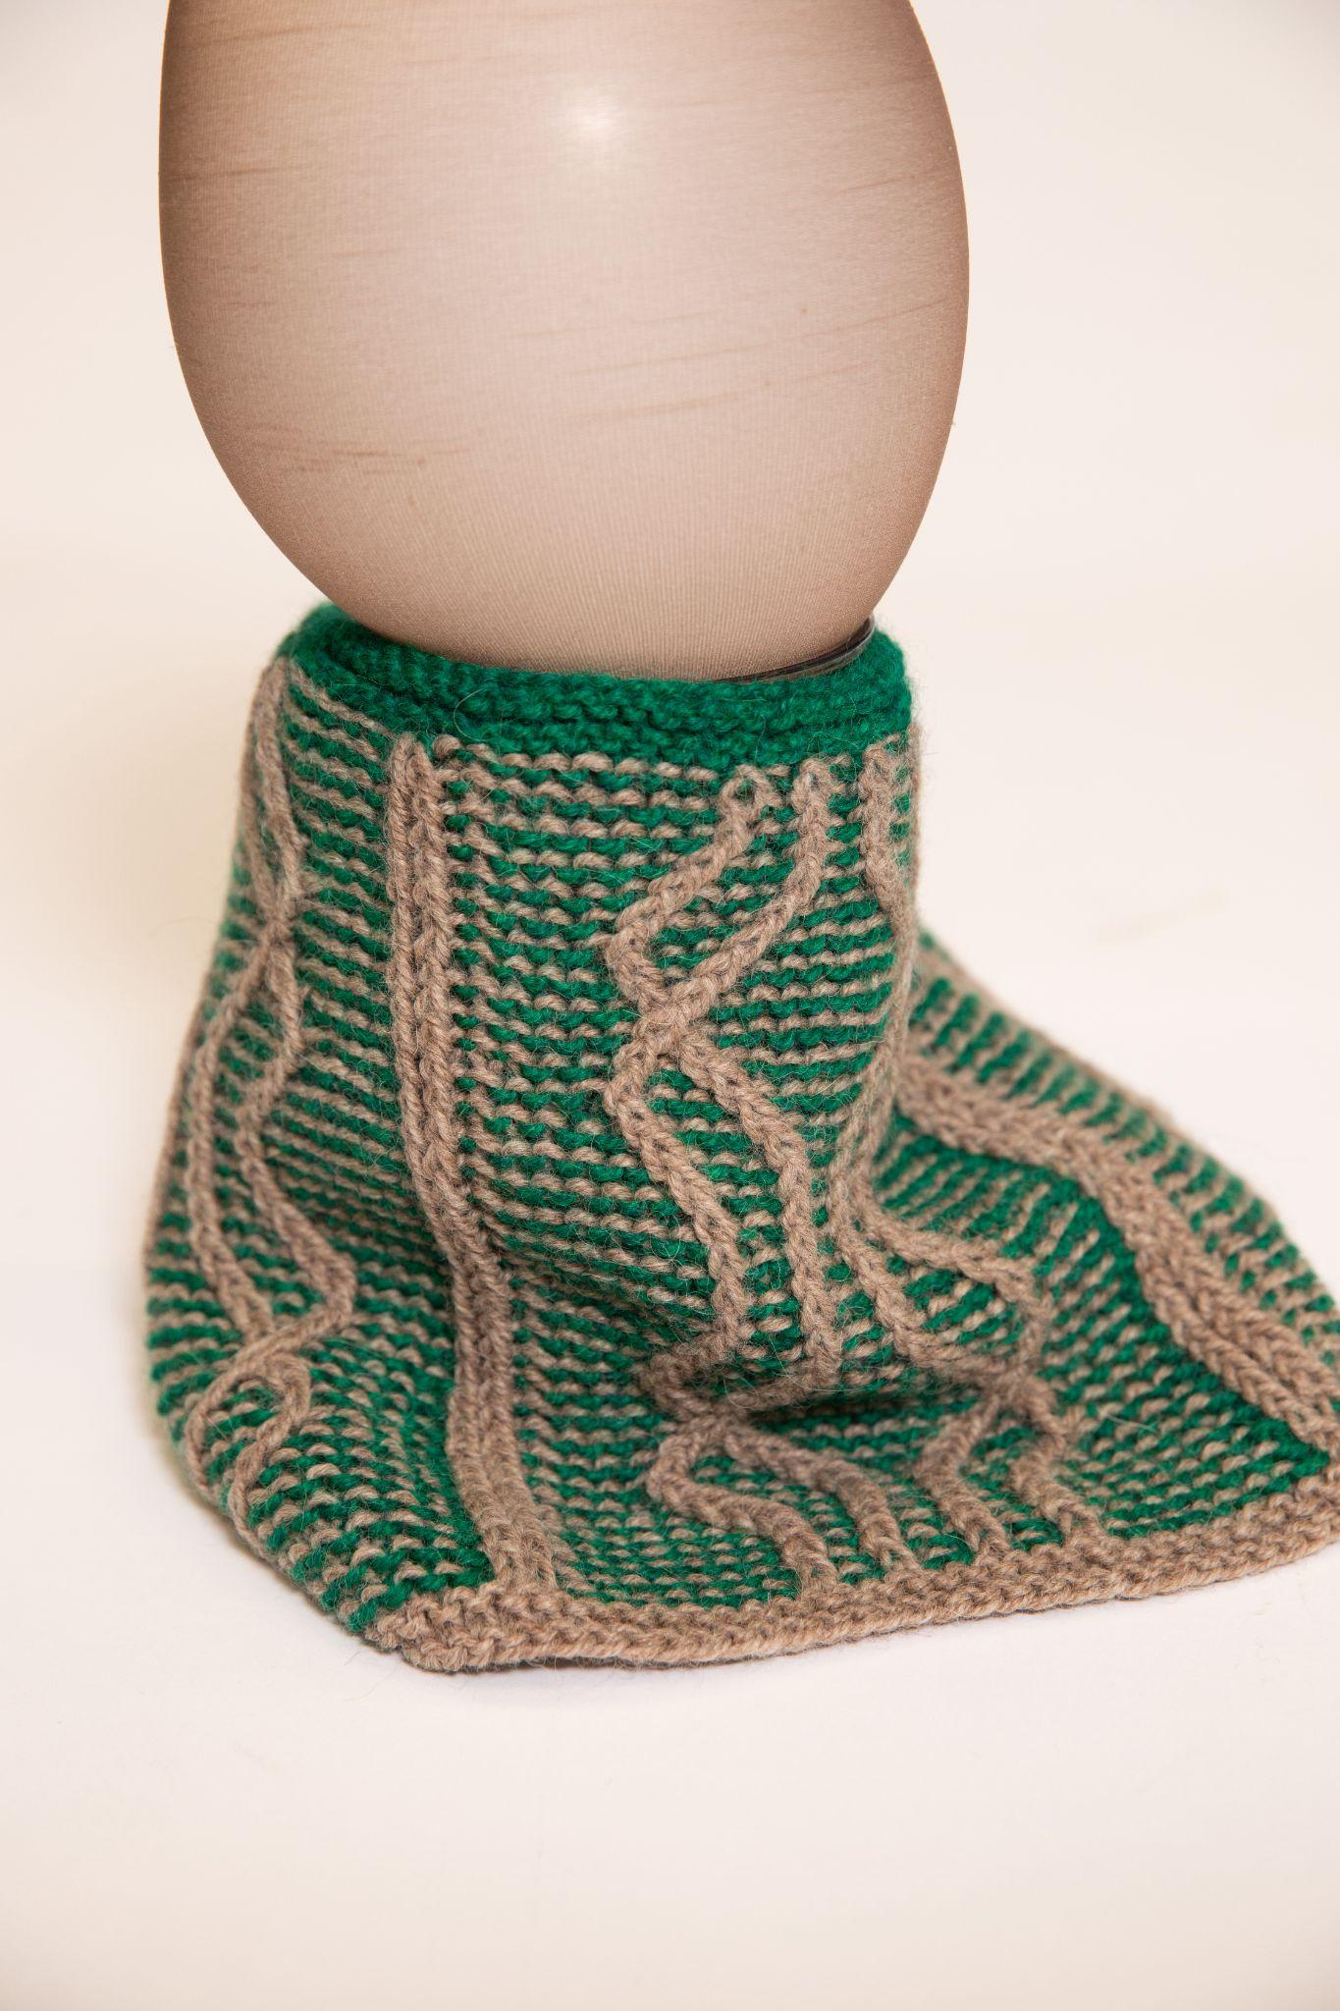
Follow the Leader Cowl by Amanda Mustard
Third Place
Yarn: Berroco Ultra Alpaca
https://www.ravelry.com/projects/AmandaDianeM/fusion-cowl

Slide 6
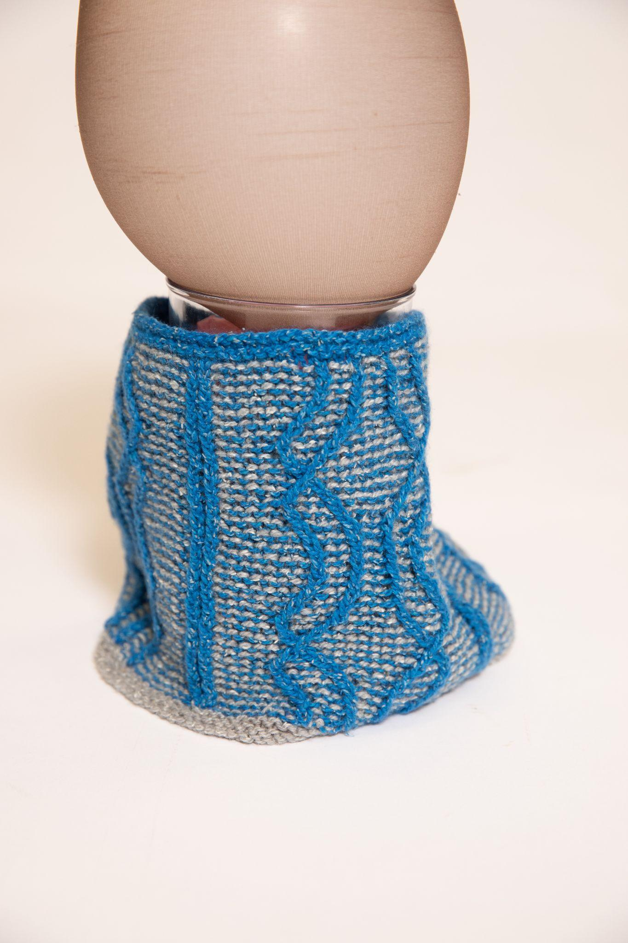
Follow the Leader Cowl by Dianne Littleton
https://www.ravelry.com/patterns/library/follow-the-leader-cowl

Slide 7
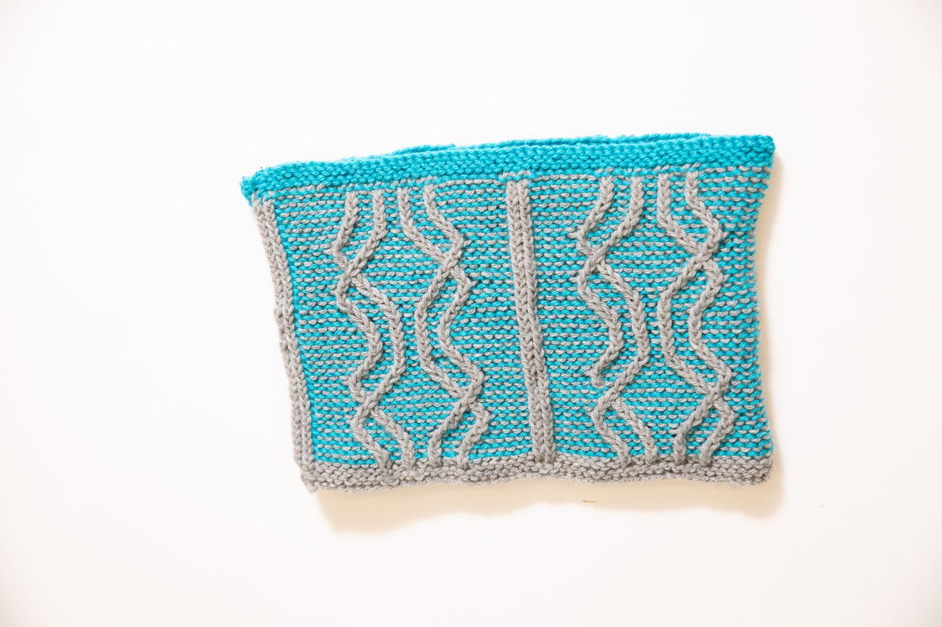
Follow the Leader Cowl by Brooke Southgate
https://www.ravelry.com/patterns/library/follow-the-leader-cowl

Slide 8
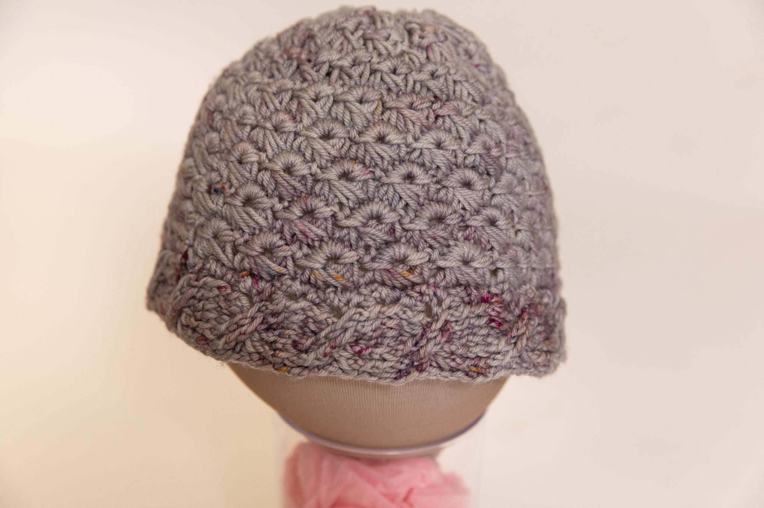
Crochet Hat by Jen Horsepool

Slide 9
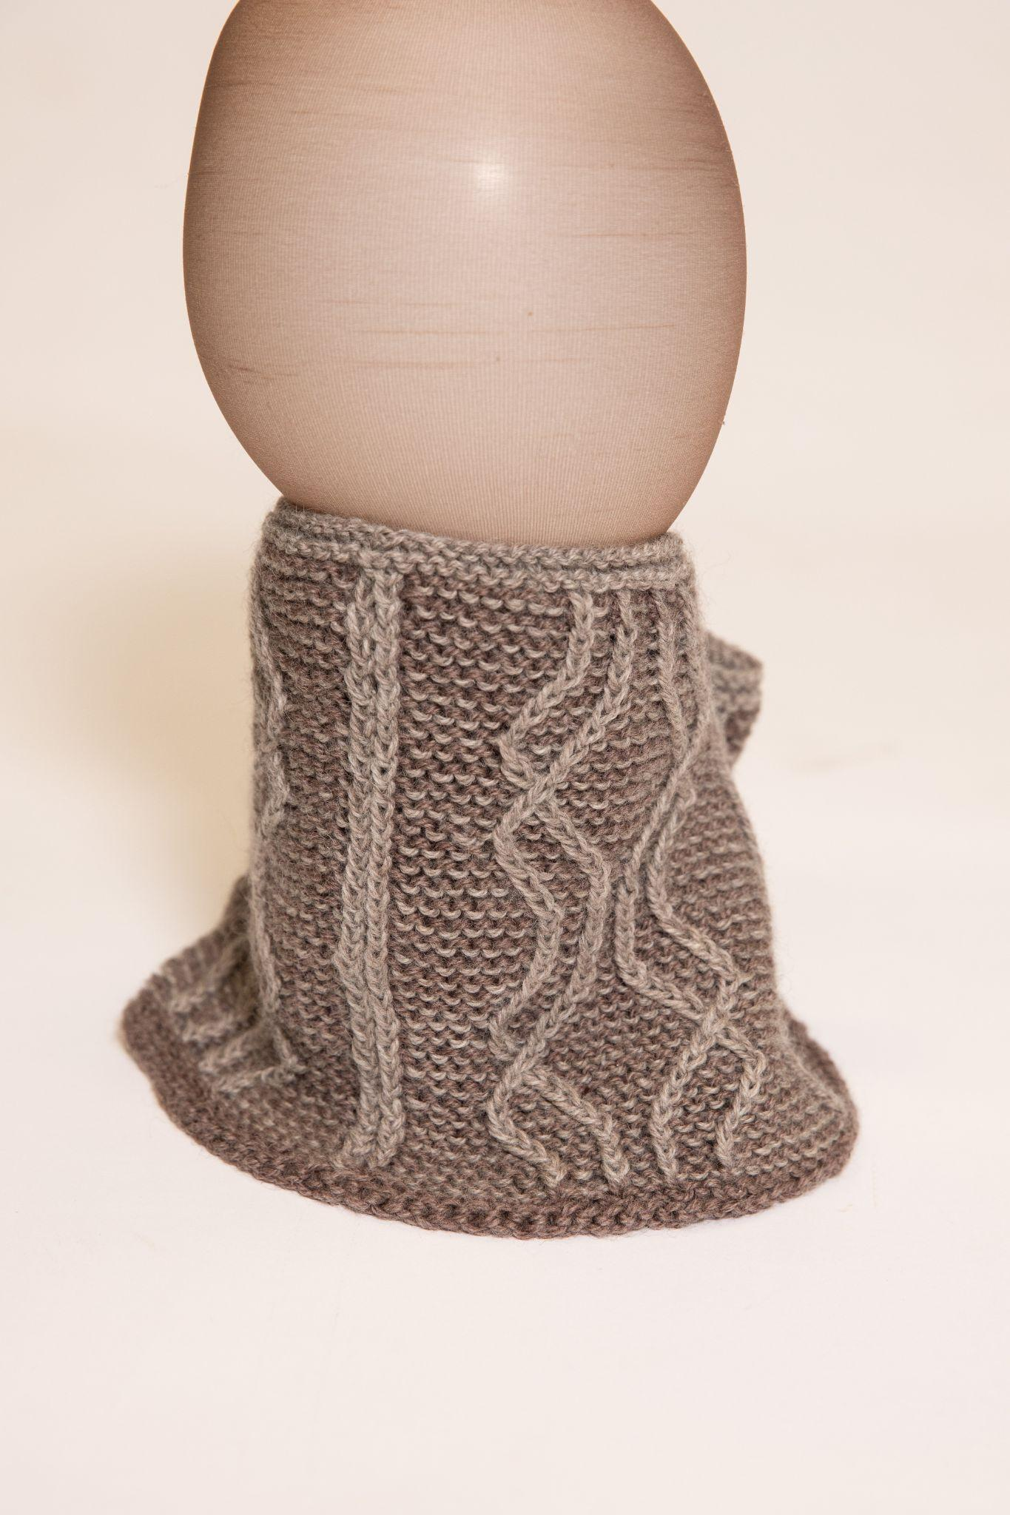
Follow the Leader Cowl by Susan Hoskins
https://www.ravelry.com/patterns/library/follow-the-leader-cowl

Slide 10
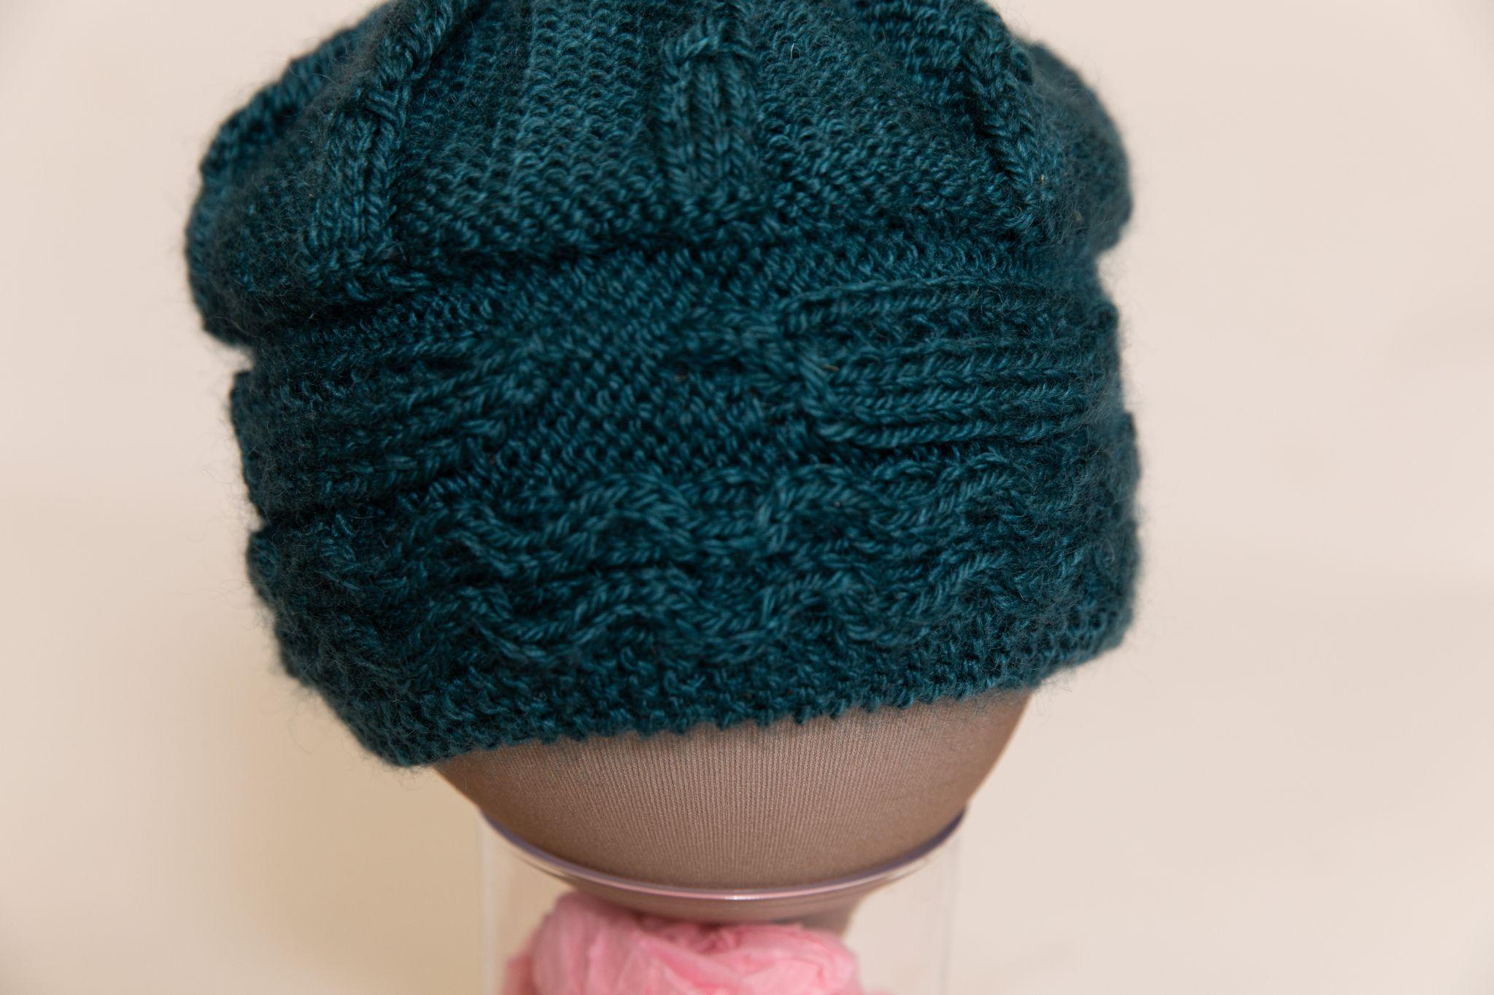
Beanie by Susan McLeod
https://www.ravelry.com/patterns/library/soft-is-the-song-my-paddle-sings

Slide 11
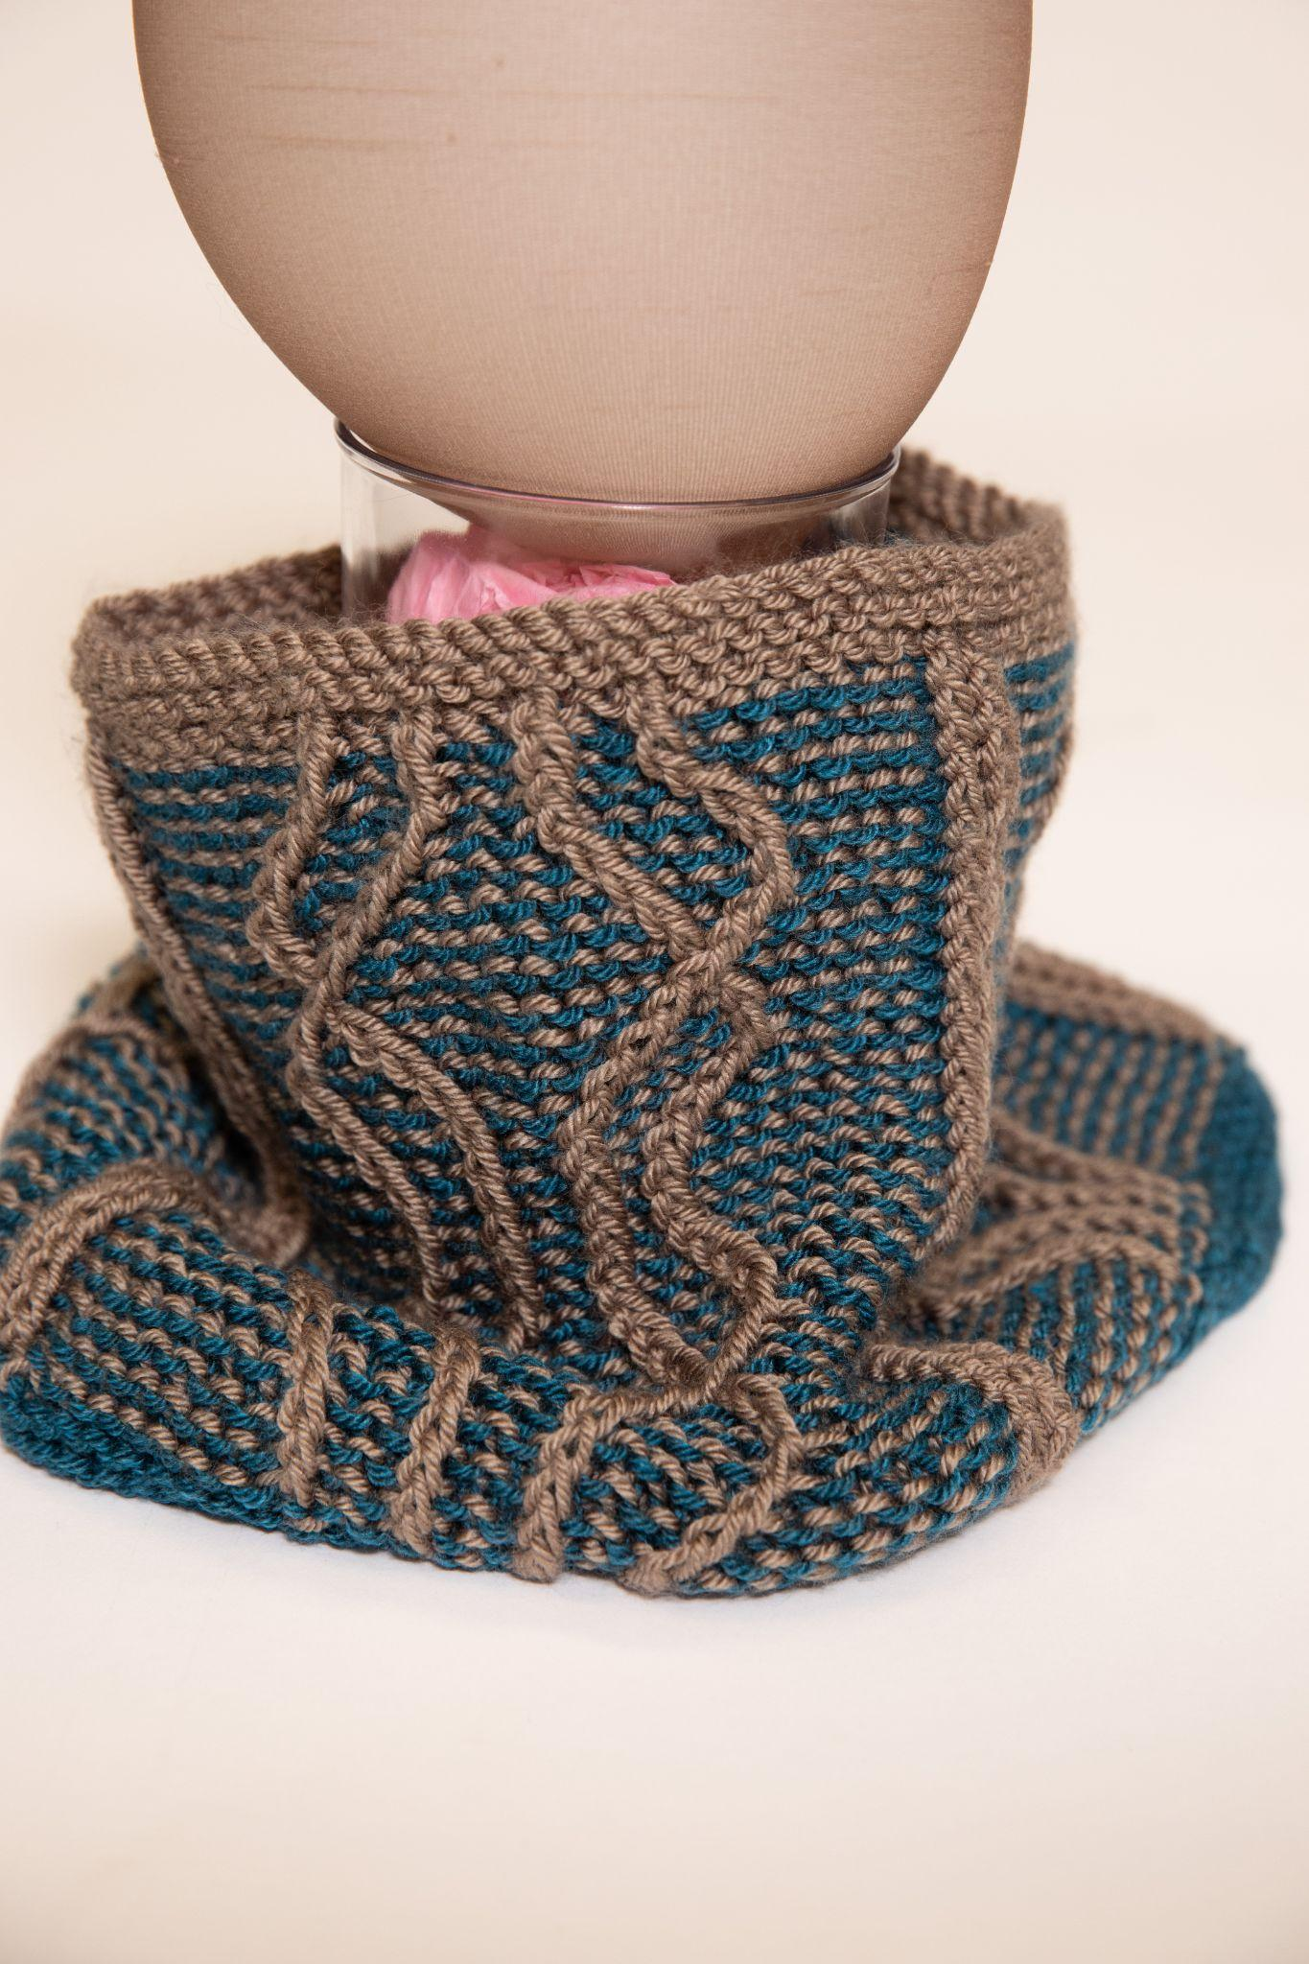
Fusion Cowl by Susan McLeod
Yarn: Patons Canadiana
https://www.ravelry.com/patterns/library/follow-the-leader-cowl

Slide 12
Category 1: Head & Neck
Main Course

Slide 13
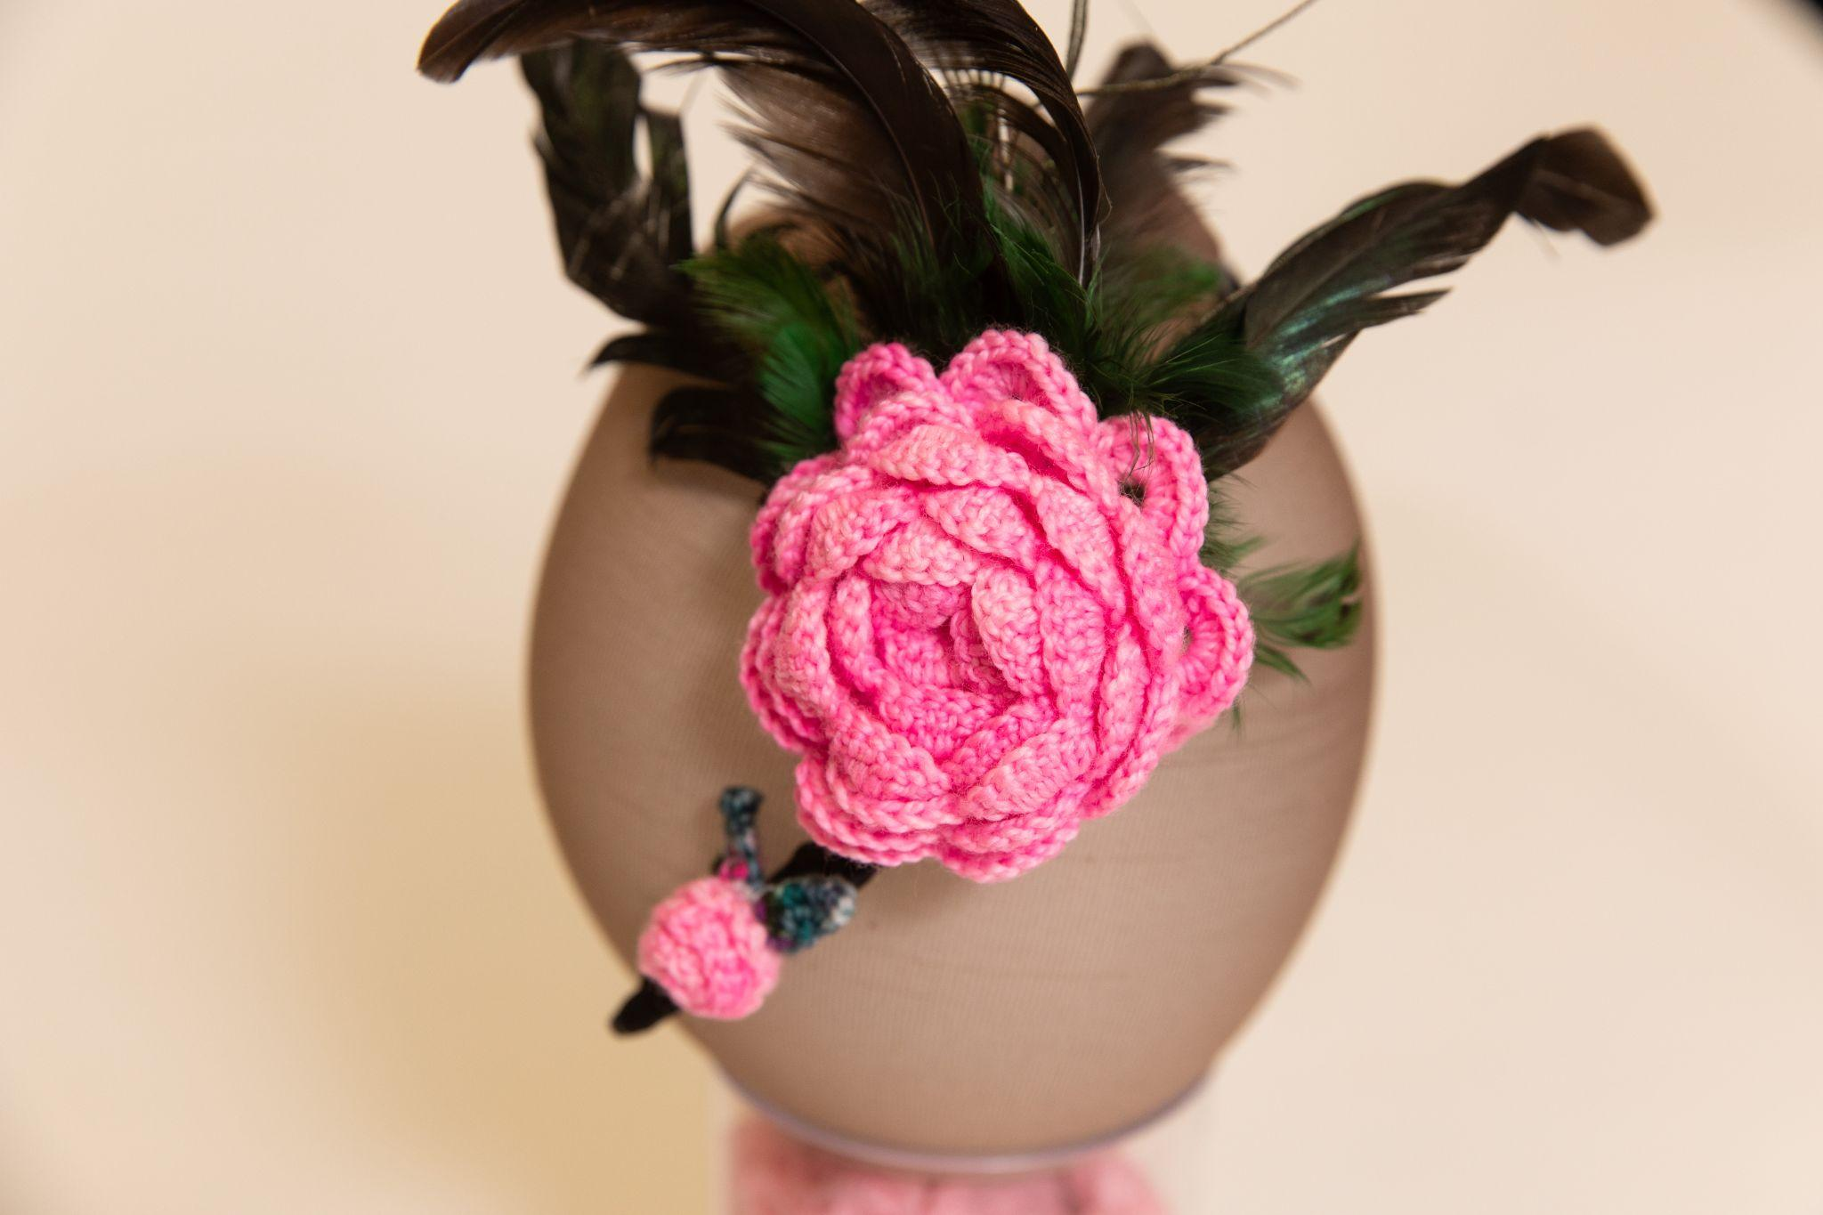
Feather Headband by Brooke Southgate
First Place

Slide 14
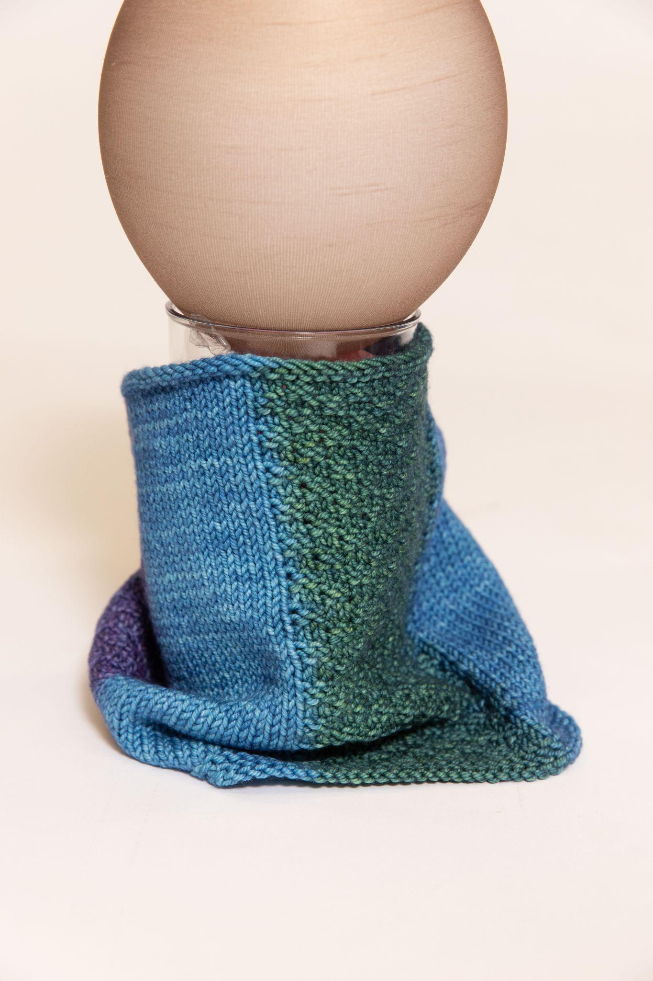
Planned Pooling Cowl by Laura Weeks
Second Place
Yarn: Ancient Arts Superwash DK/Light Worsted
https://ravelry.com/projects/purplemathmom/colour-stacked-cowl

Slide 15
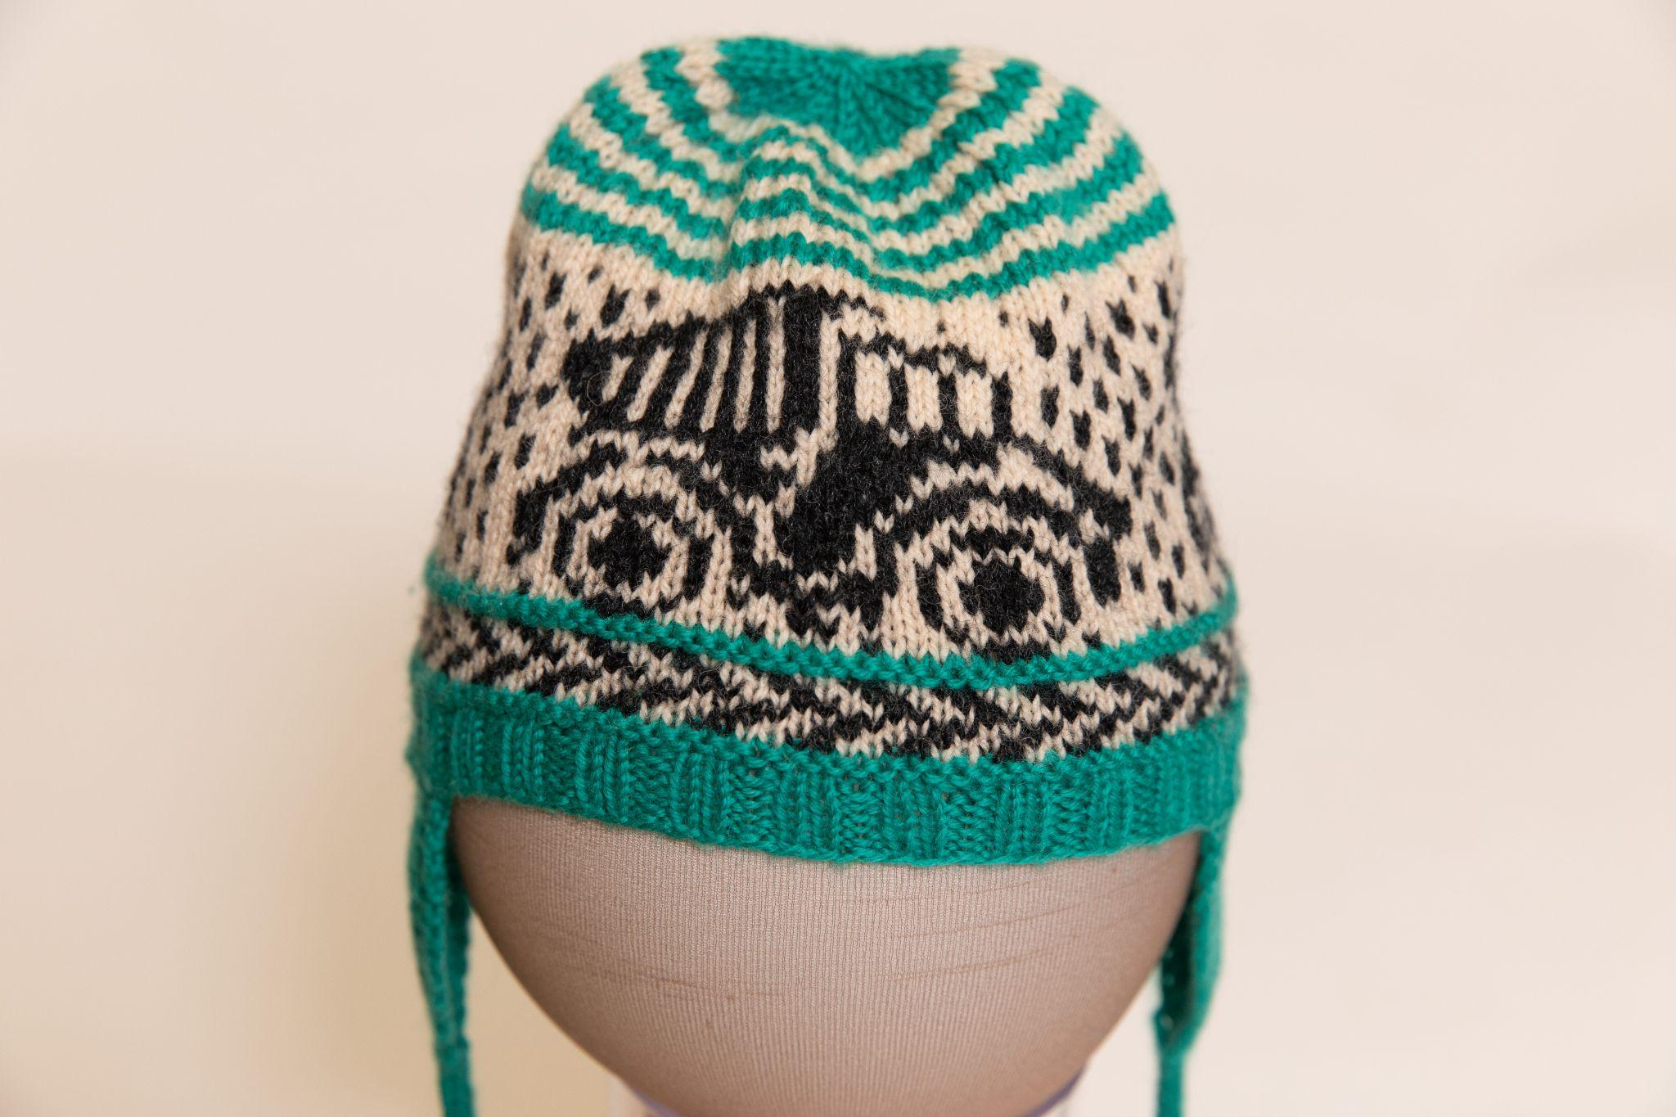
Baby Hat by Debbie Bolt
Third Place
Yarn: Knit Picks Palette
https://www.ravelry.com/projects/dbtinksalot/dump-truck-hat

Slide 16
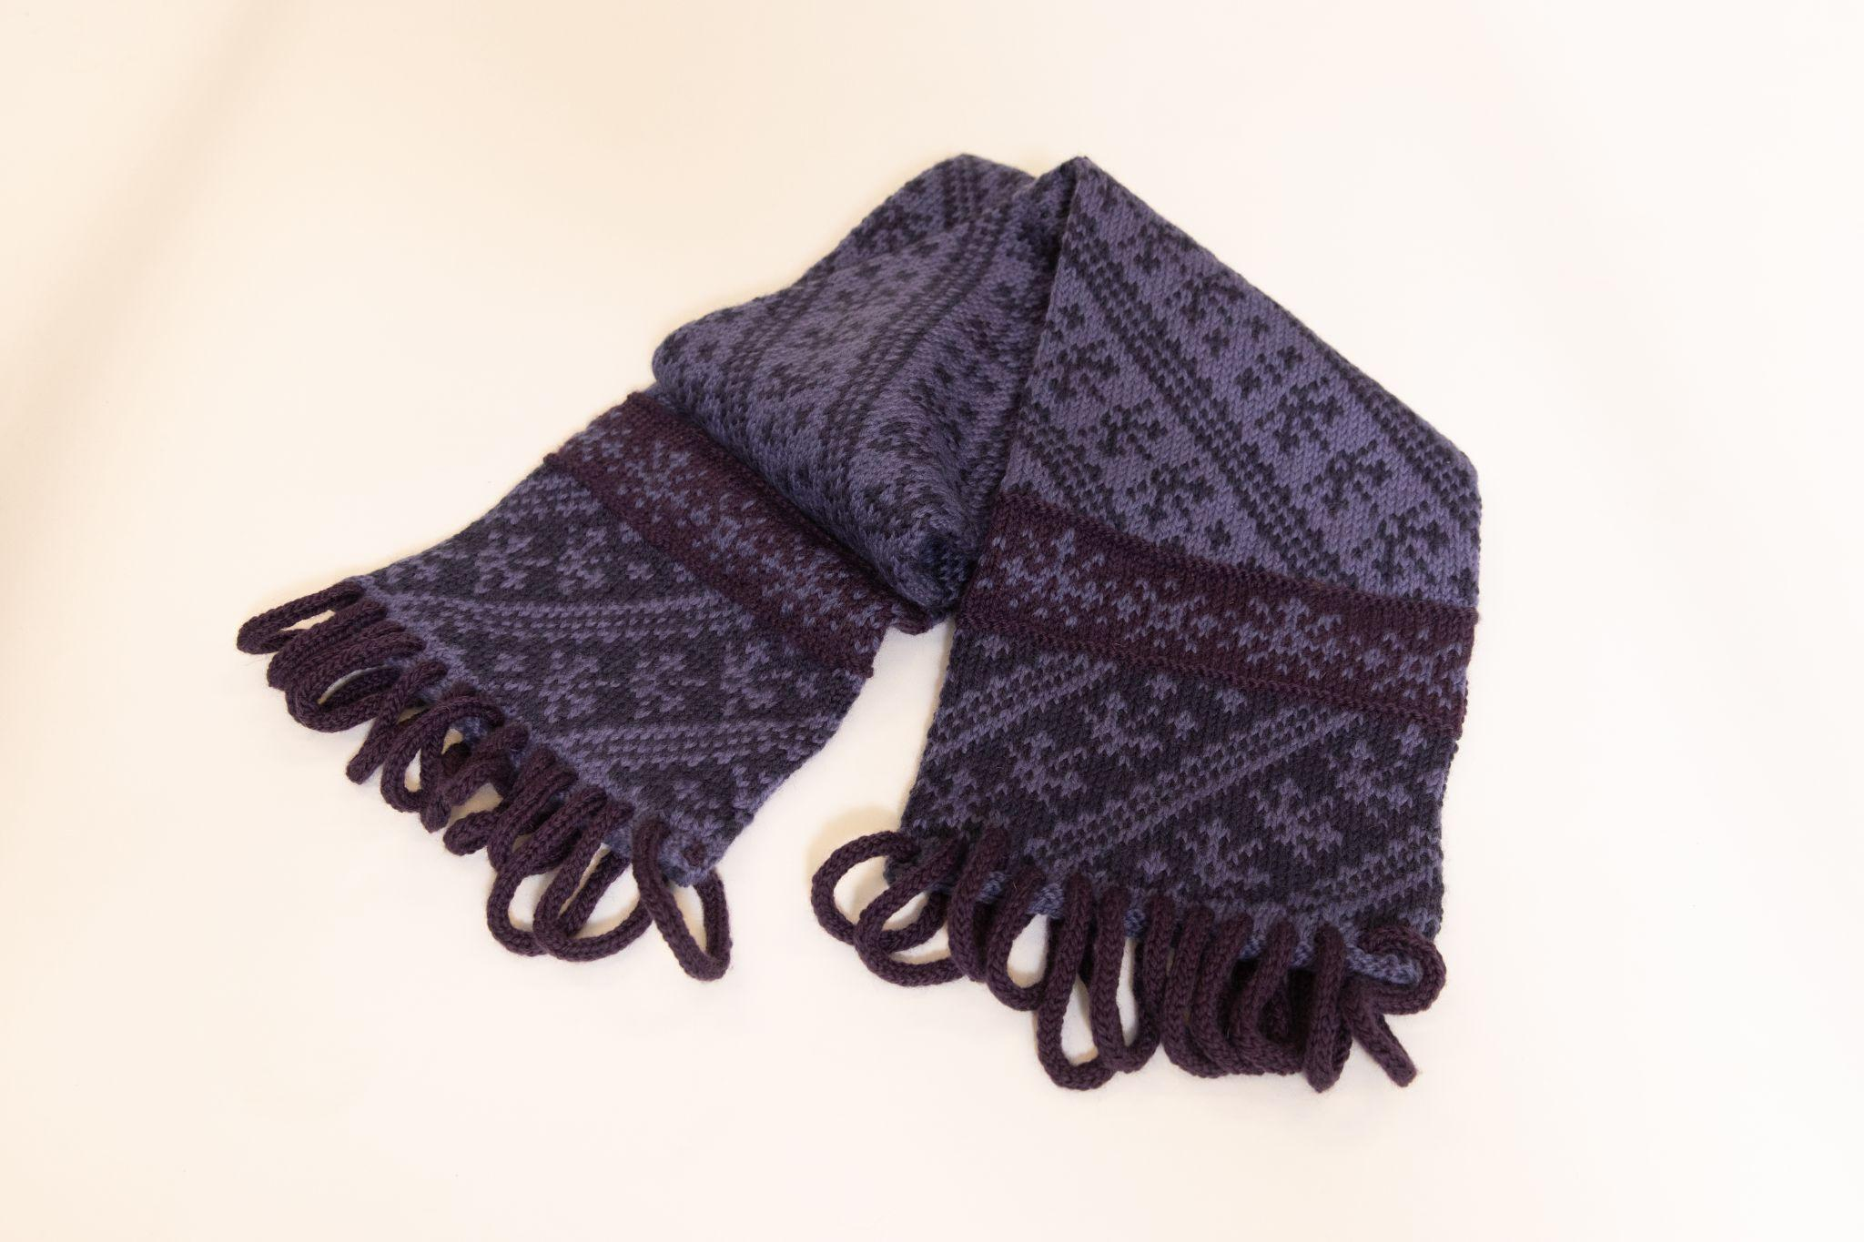
Fair Isle and I-Cord Scarf by Betty Bax

Slide 17
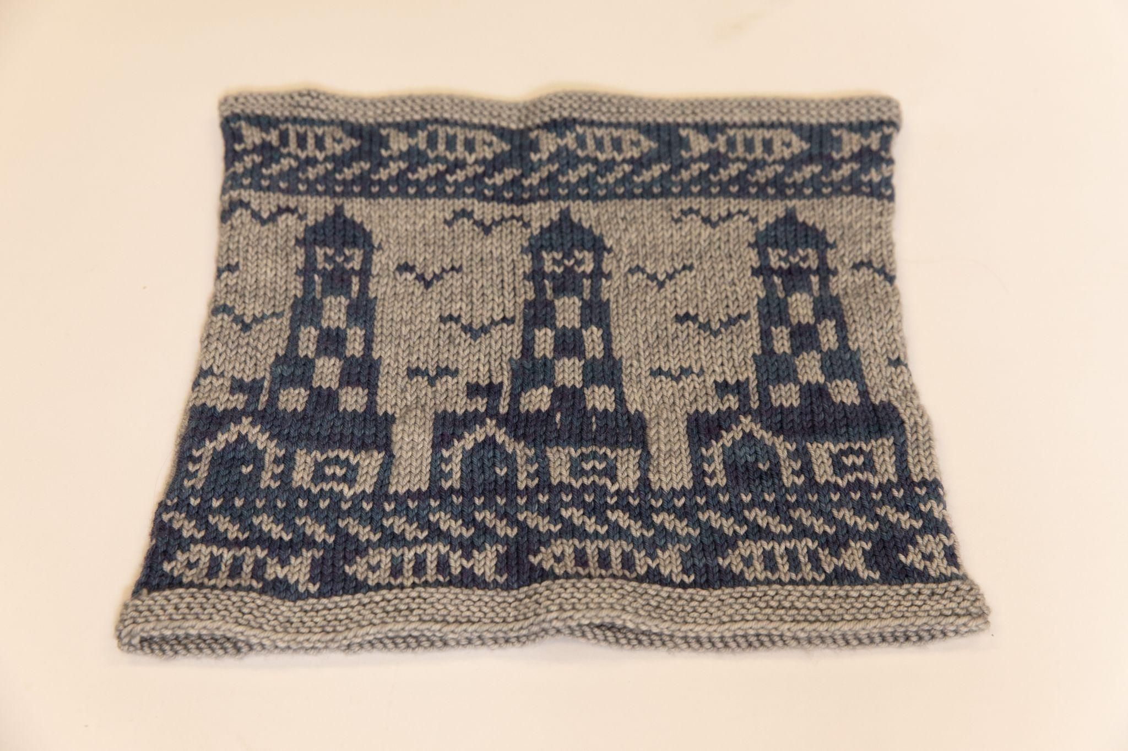
Lighthouses of Maine Cowl by Laura Weeks
Yarn: Seven Sisters Arts Zodiac
https://ravelry.com/projects/purplemathmom/lighthouses-of-maine-cowl

Slide 18
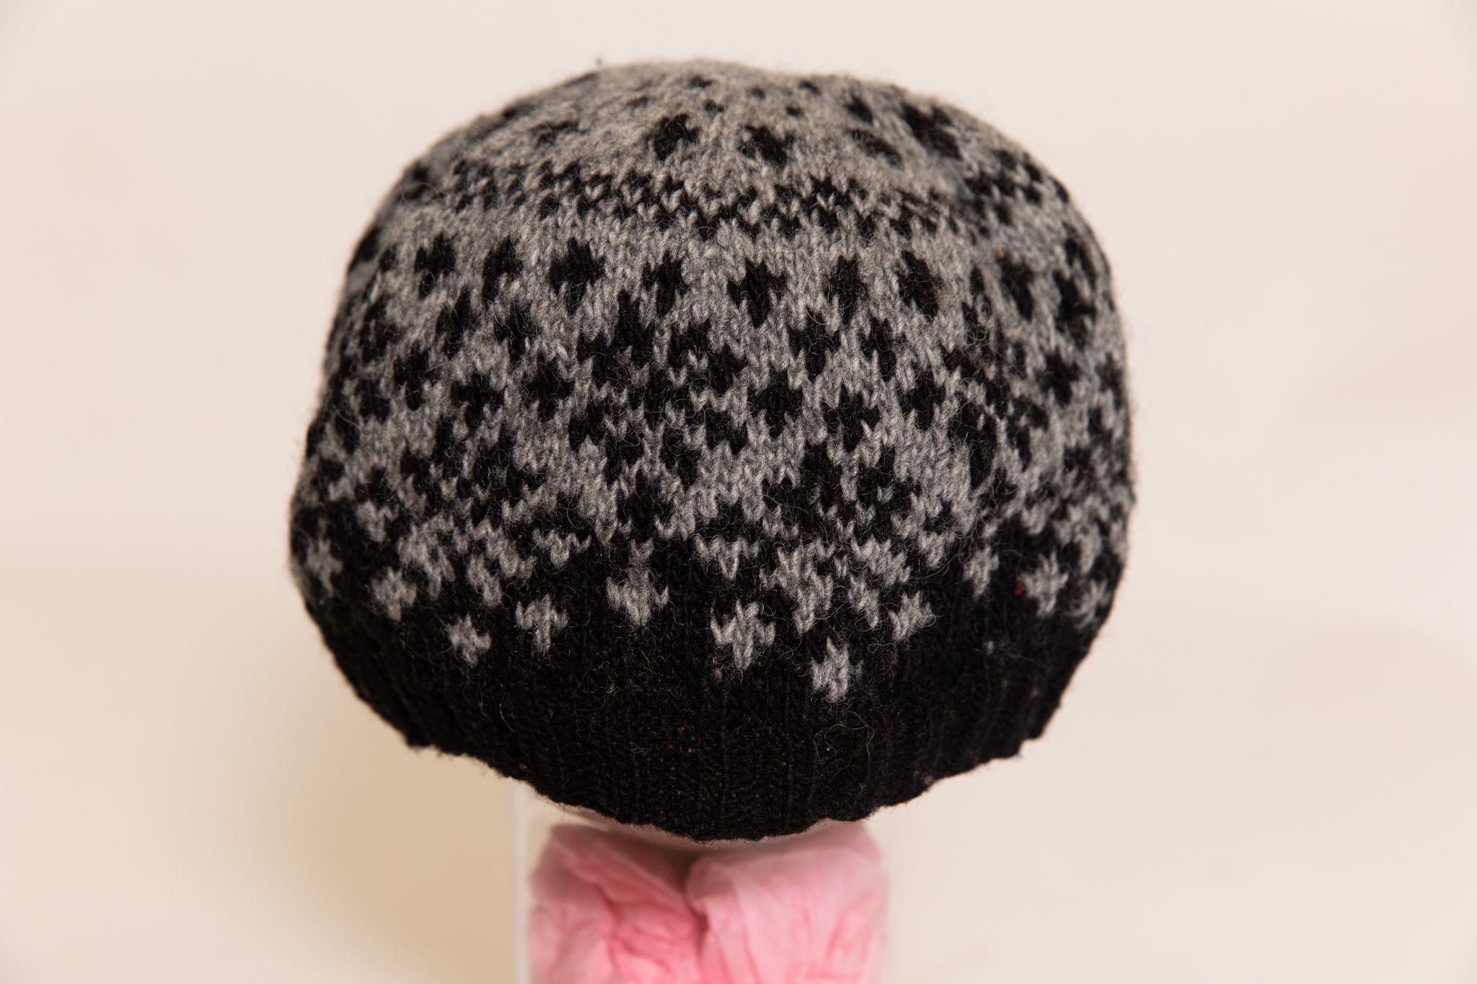
Schneeflocken Hat by Miriam Heynen
Yarn: Briggs & Little Durasport
https://www.ravelry.com/projects/CanadianKnitizen/schneeflocken-hat-5

Slide 19
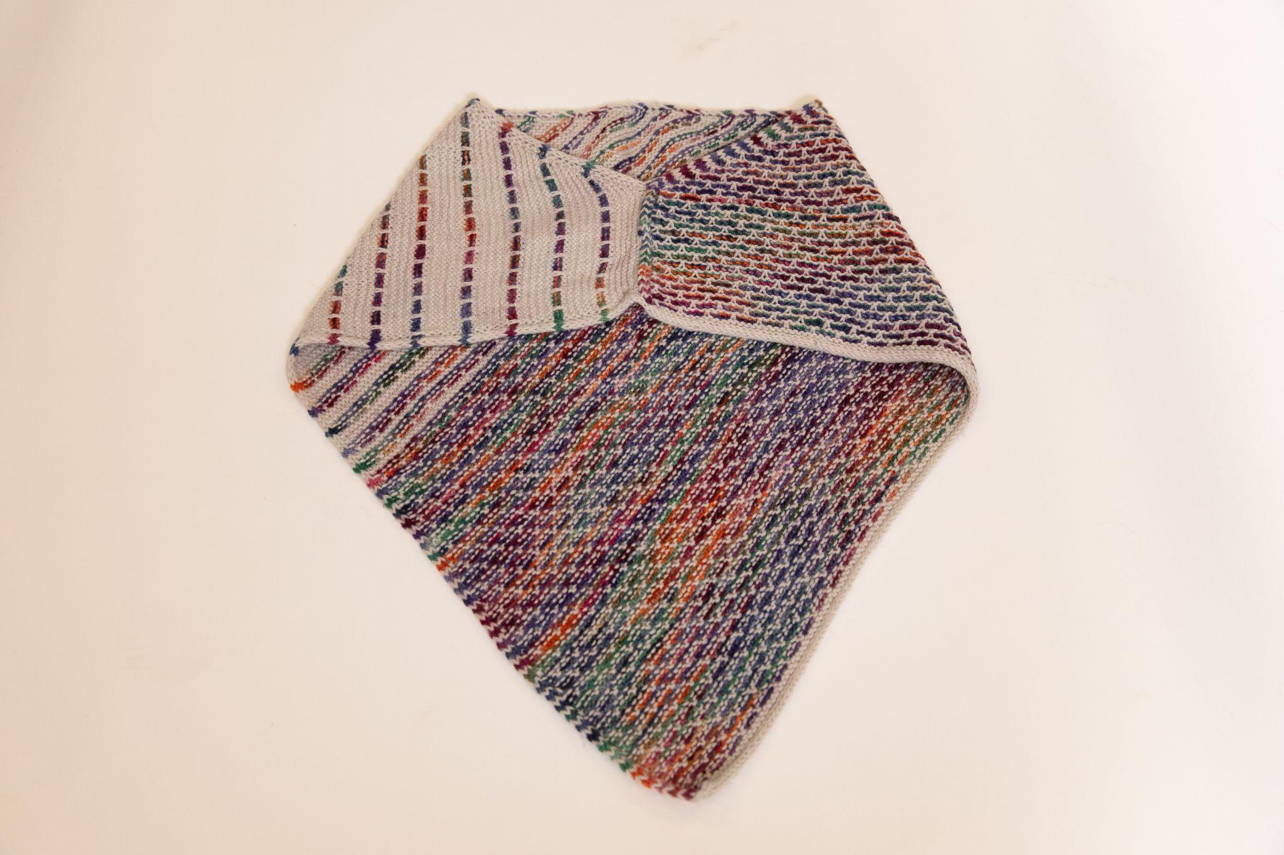
Slip Stitch Cowl by Miriam Heynen
Yarn: Cascade Heritage Sock and Koigu KPPPM
https://www.ravelry.com/projects/CanadianKnitizen/conversation-cowl

Slide 20
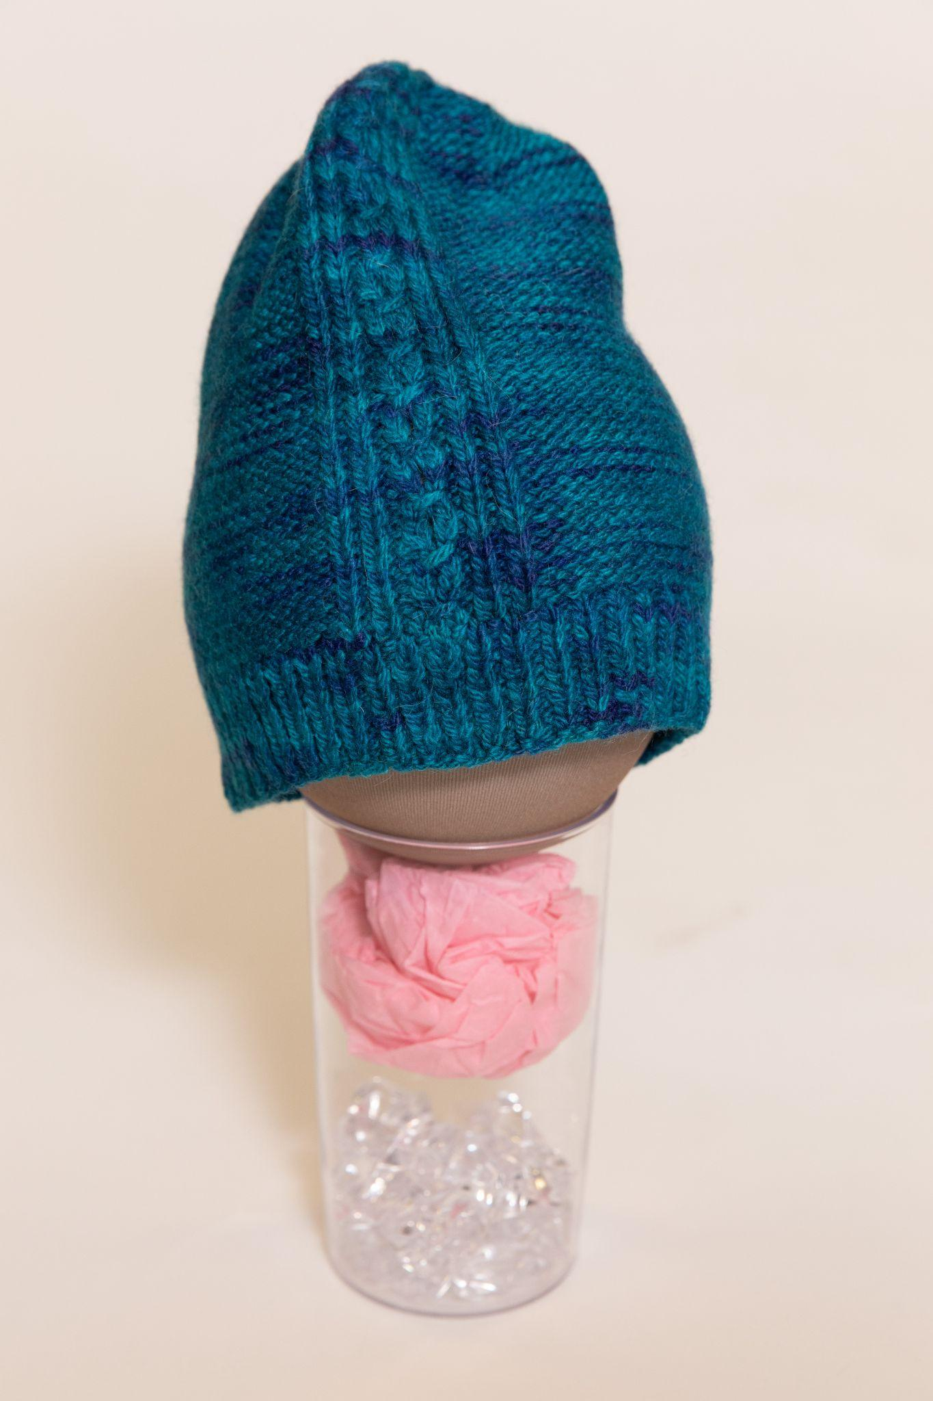
Beanie by Rosemary Kohler
Yarn: Knotty by Nature Worsted
https://www.ravelry.com/projects/goldenrex/renfrew

Slide 21
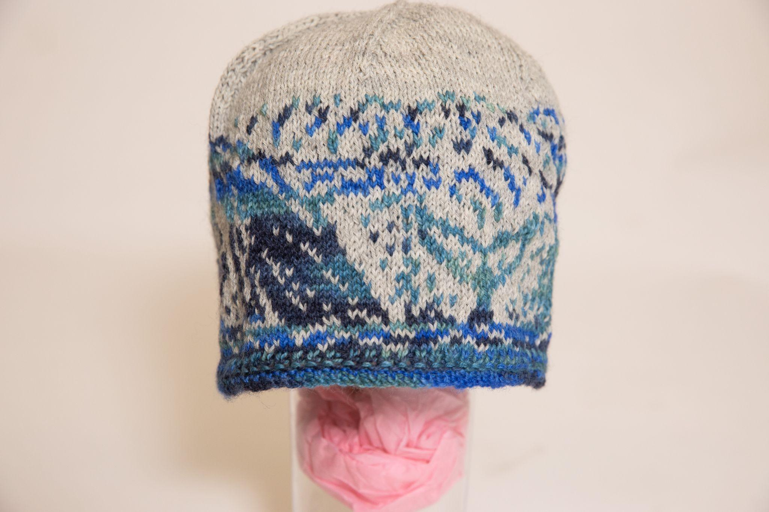
Stranded Whales Beanie by Susan McLeod
https://www.ravelry.com/patterns/library/stranded-whales-beanie

Slide 22
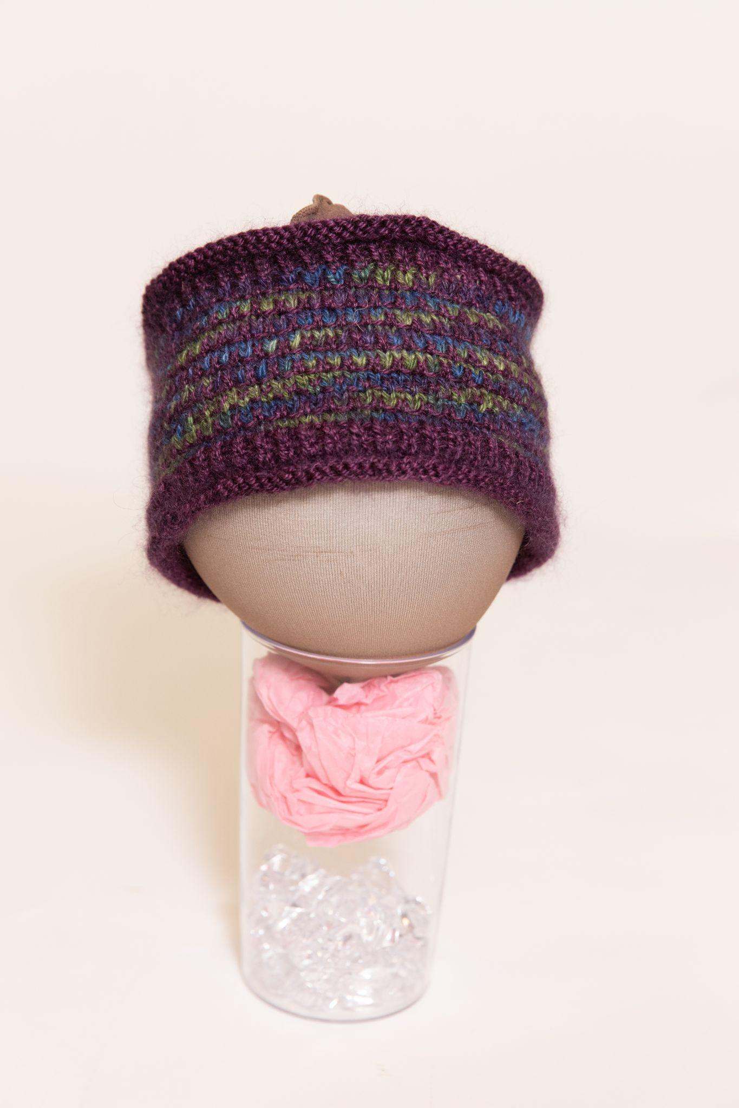
Wellington Slipstitch Headband by Susan McLeod
https://www.ravelry.com/patterns/library/wellington-slipstitch-headband

Slide 23
Category 1: Head & Neck
Dessert

Slide 24
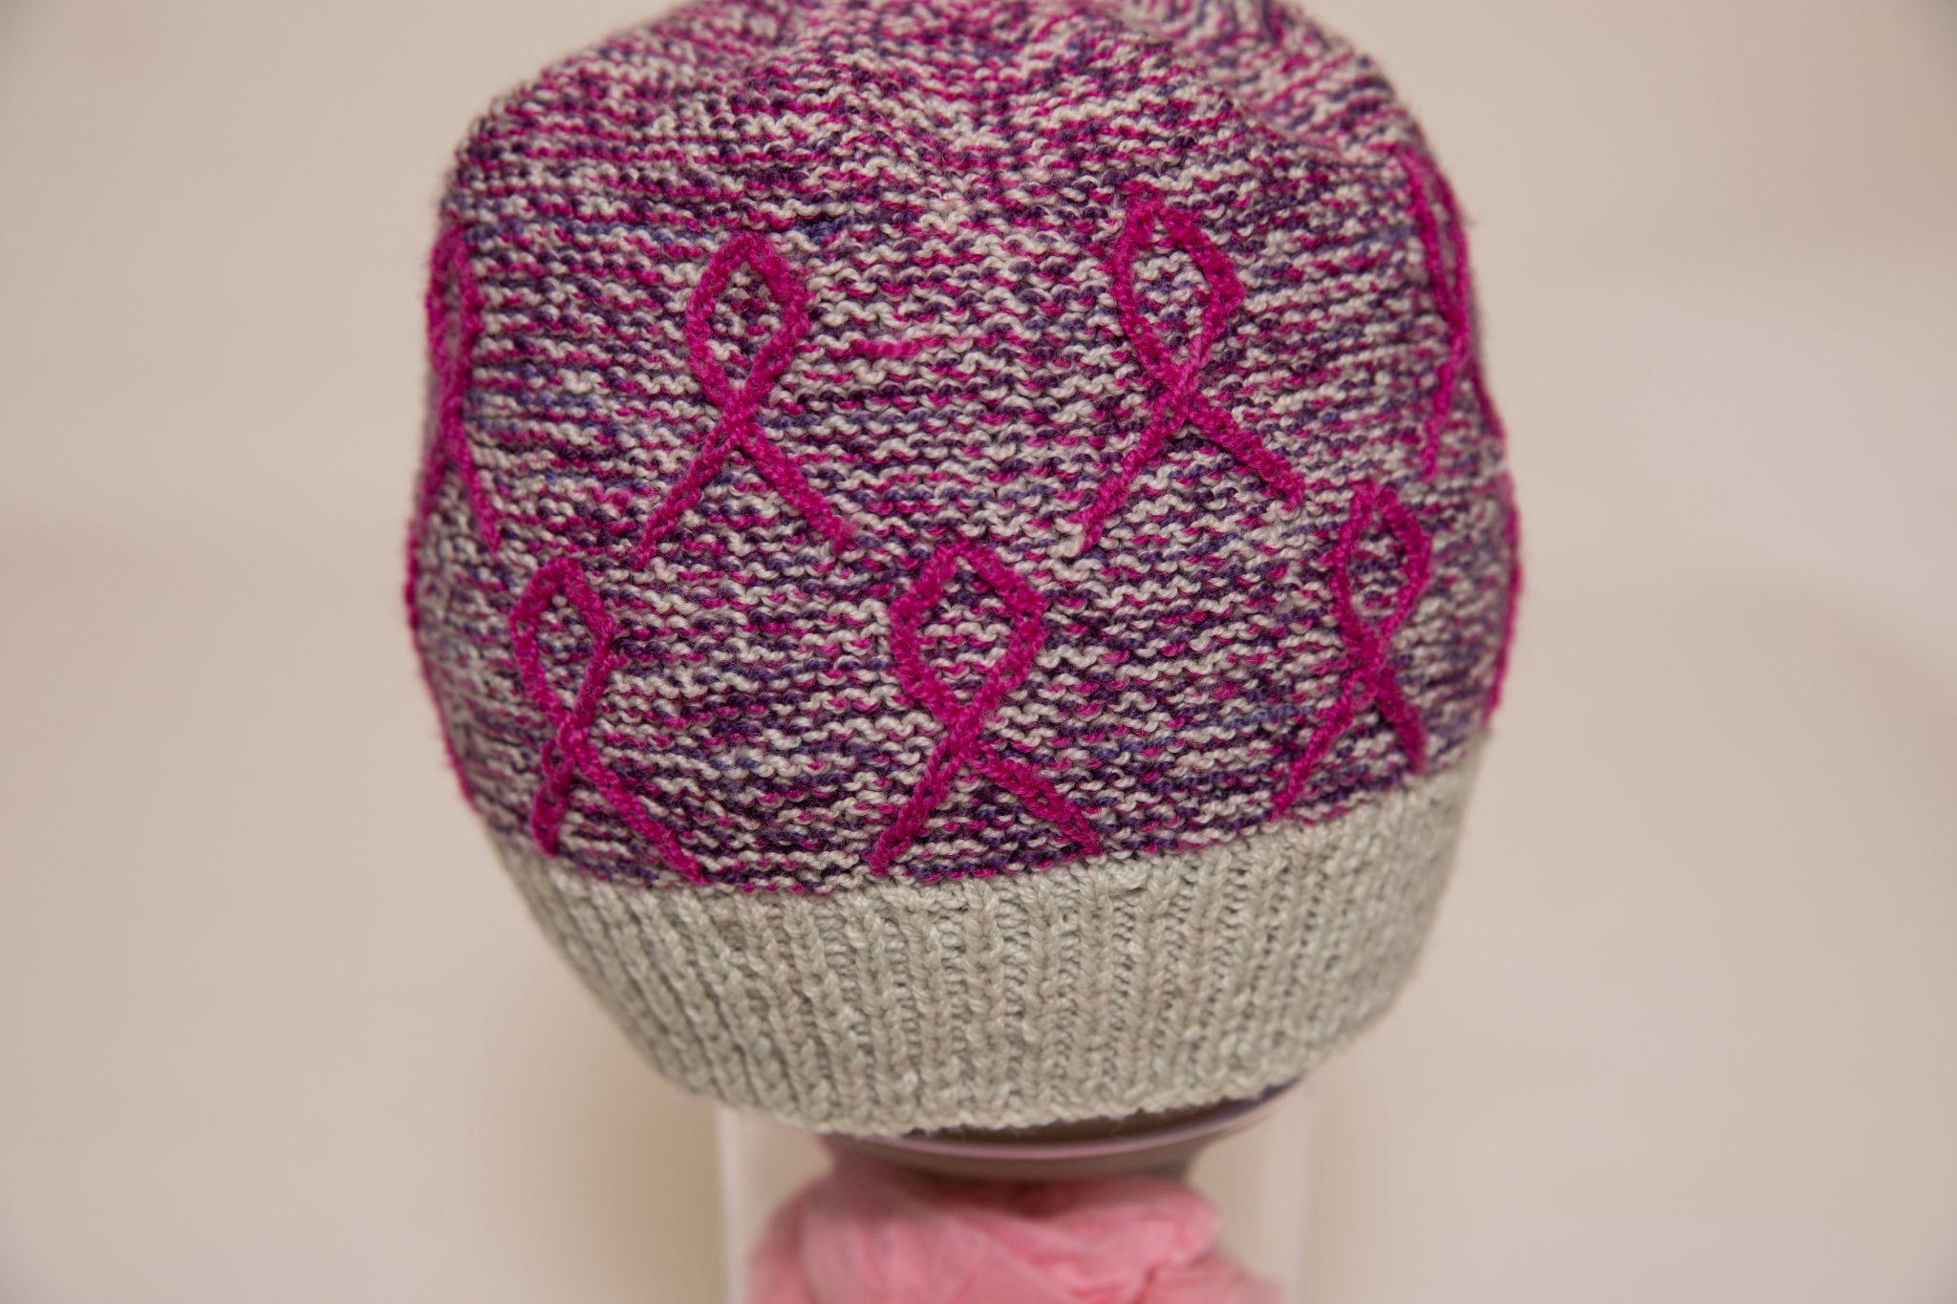
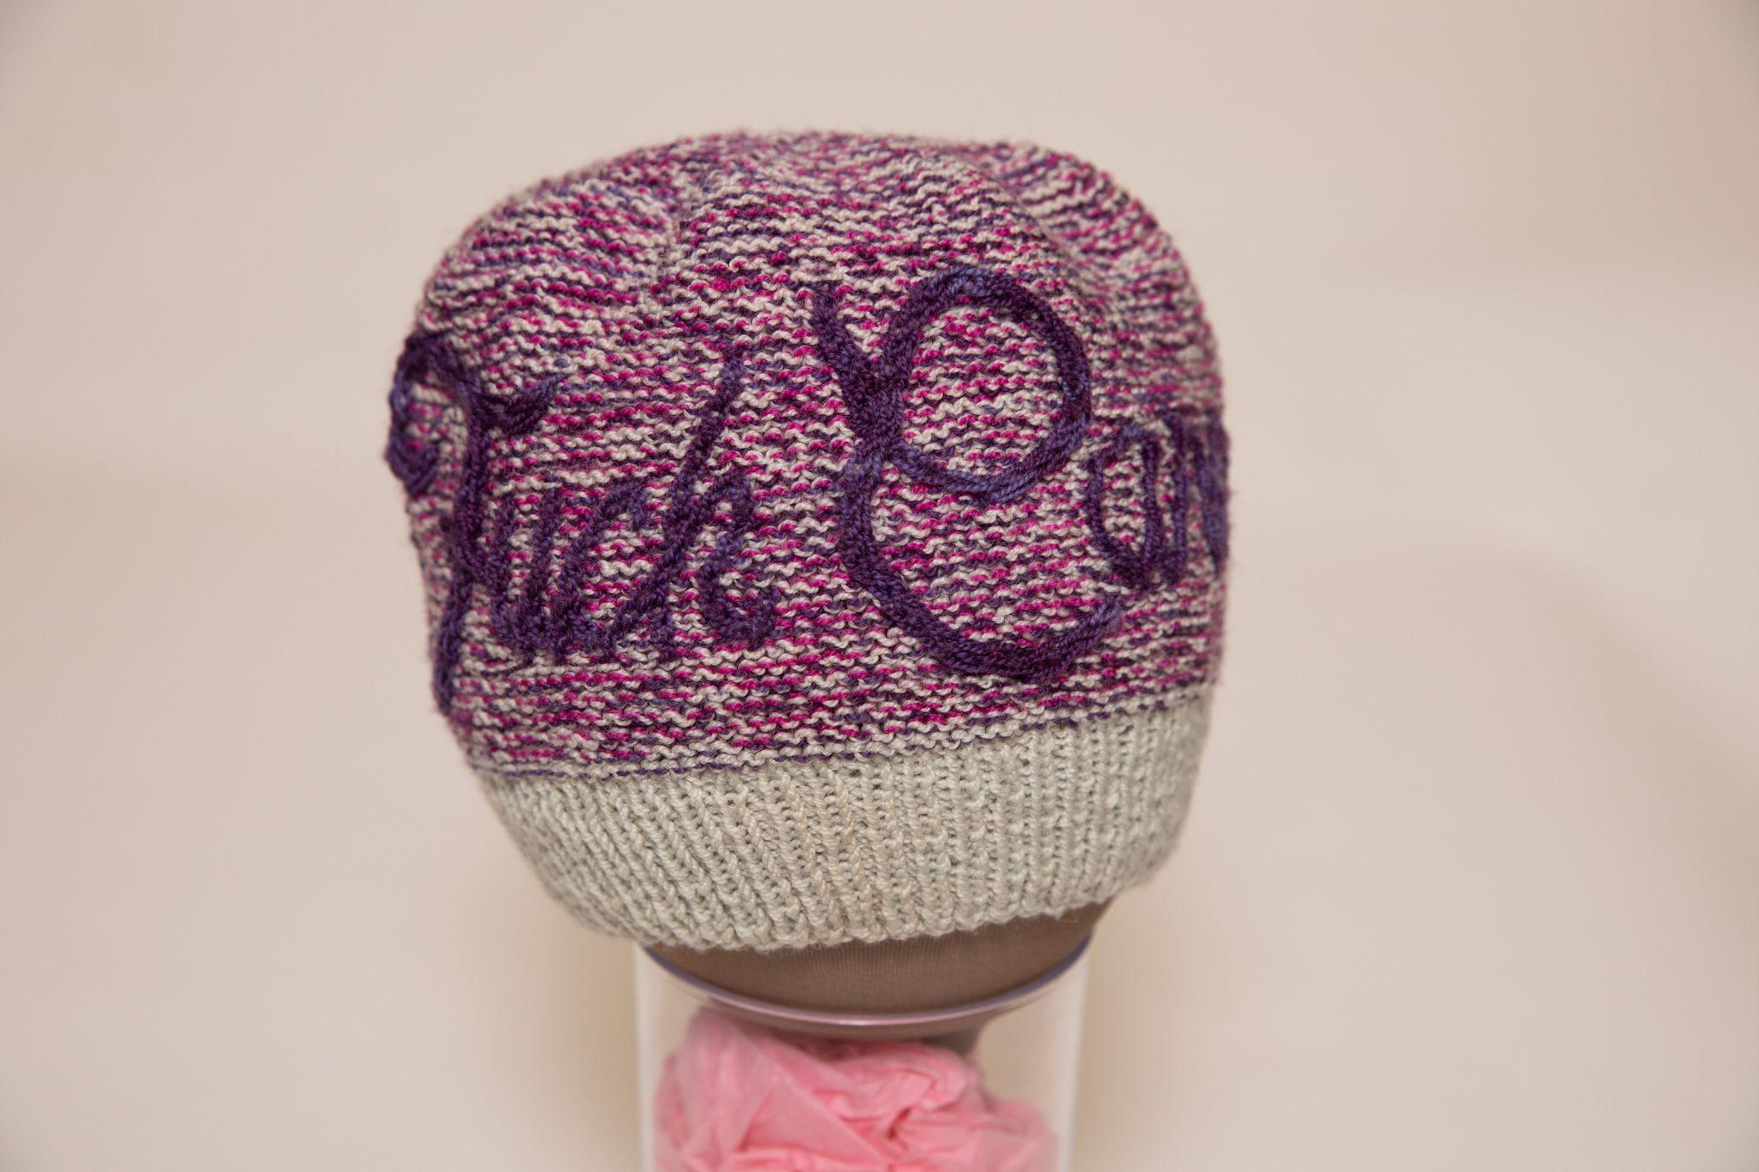
Fuck Cancer Hat by Mary Martin
First Place
Yarn: Koigu Lace Merino
https://www.ravelry.com/projects/MaryWMartin/fuck-cancer-hat-inside-or-out

Slide 25
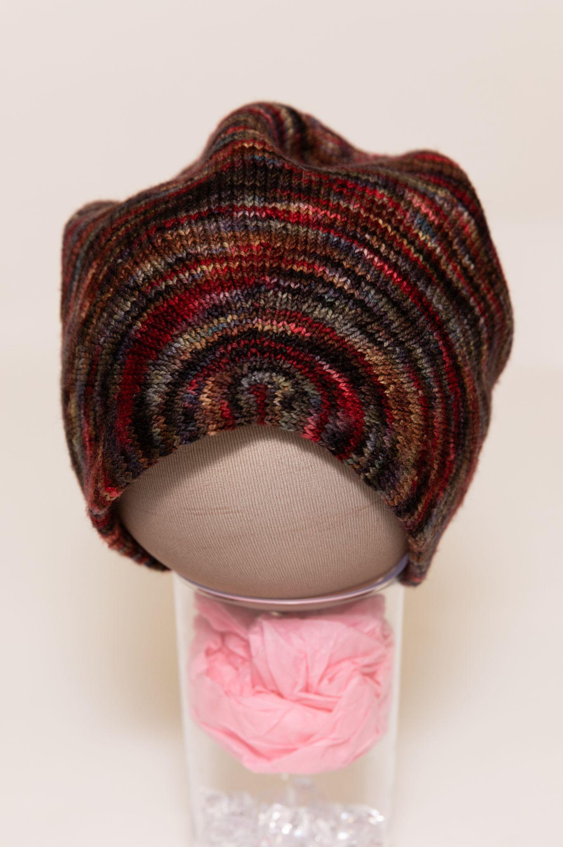
Beanie by Anne Blayney
Second Place
Yarn: indigodragonfly Merino Sock
https://www.ravelry.com/projects/AnnieBee/circle--square

Slide 26
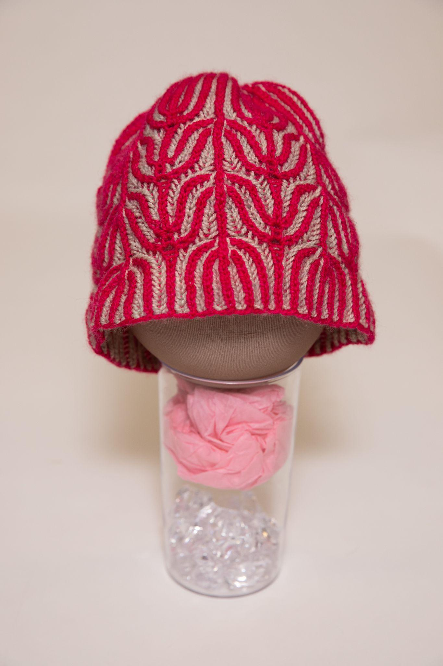
Brioche Beanie by Anne Blayney
Third Place
Yarn: Emily C Gillies BFL Fingering
https://www.ravelry.com/projects/AnnieBee/presage

Slide 27
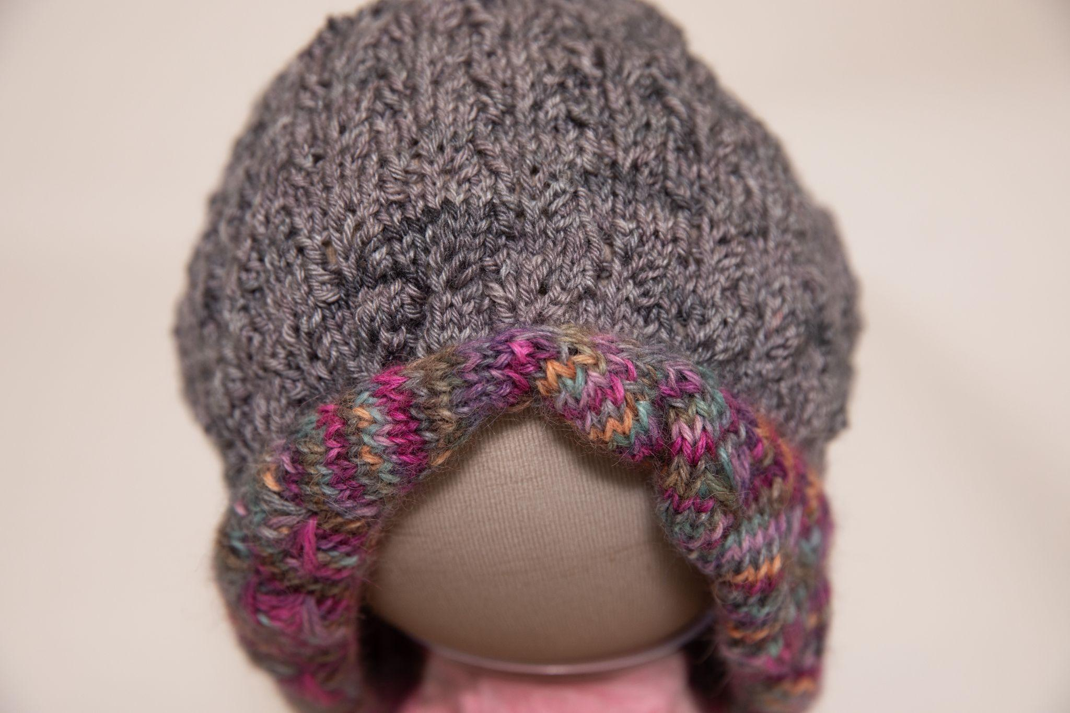
Wild Fields Beanie by Johanna Botari
Yarn: Cascade 220 Superwash and The Alpaca Yarn Co Paca-Paints
https://www.ravelry.com/projects/johannab/wild-fields

Slide 28
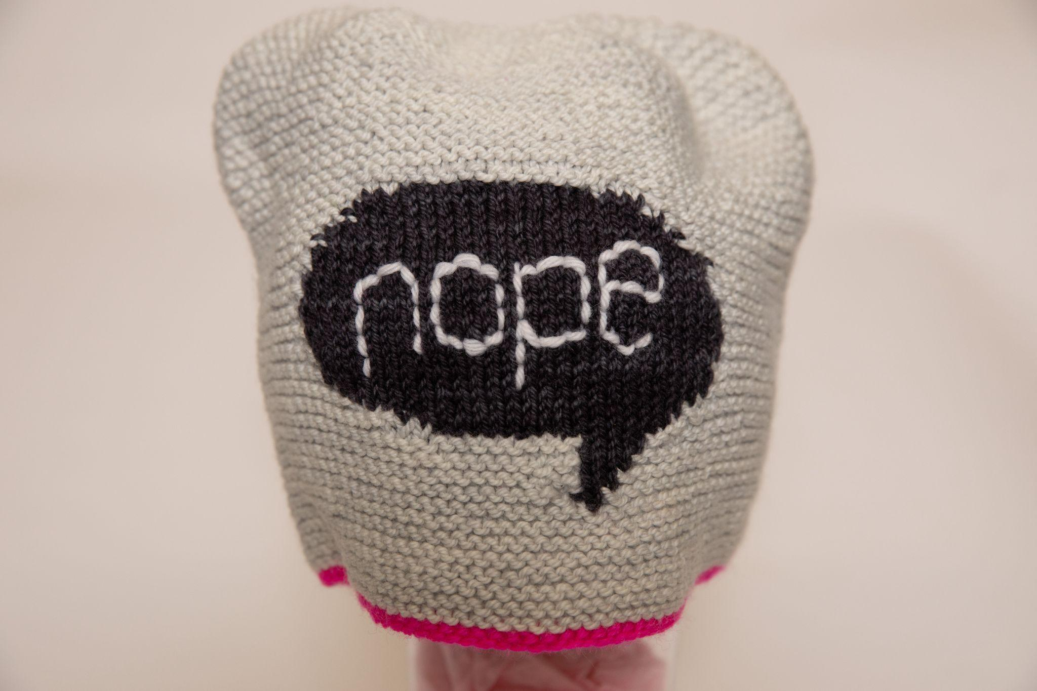
Talking Heads Hat by Lynne Sosnowski
Yarn: Tanis Fibre Arts DK
https://www.ravelry.com/patterns/library/talking-heads

Slide 29
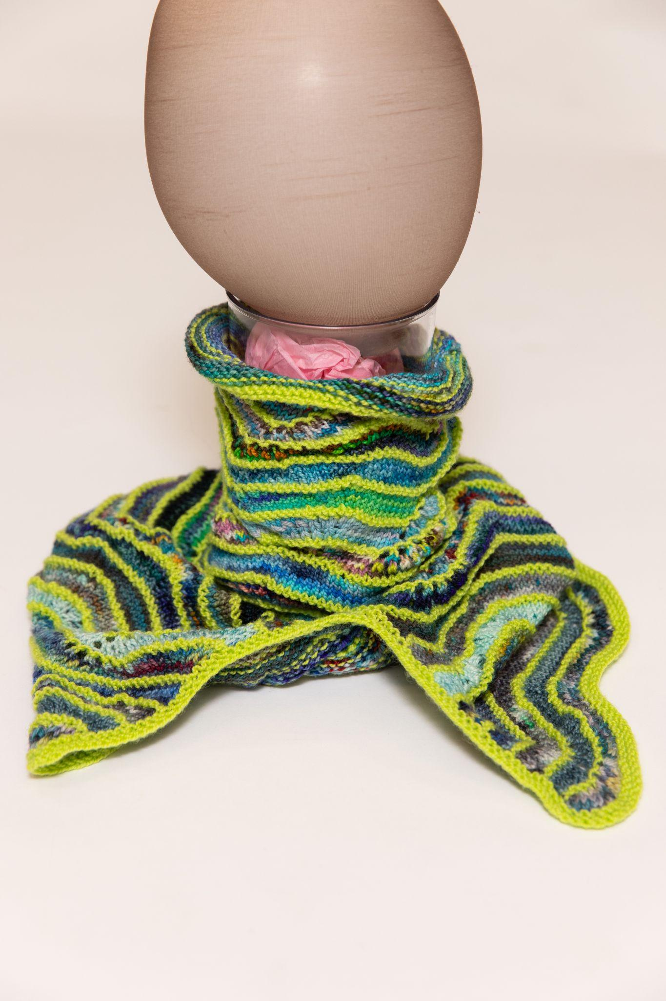
Adventagious Cowl by Lynne Sosnowski
Yarn: Koigu
https://www.ravelry.com/patterns/library/adventagious-cowl

Slide 30
Category 2: Shoulders
Appetizers (Firsts)

Slide 31
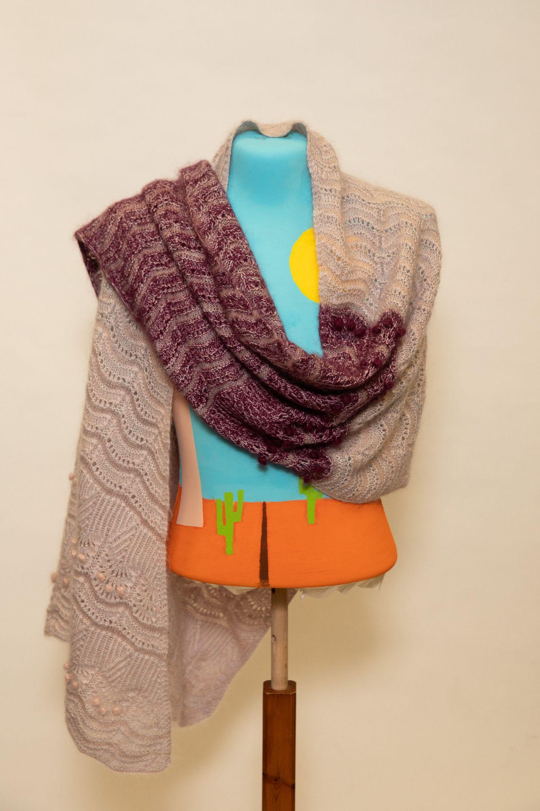
Stars In Your Hands Shawl by Amanda Mustard
First Place
Yarn: Gepard Garn Kid Seta and WYS Exquisite Lace
https://www.ravelry.com/projects/AmandaDianeM/stars-in-your-hands

Slide 32
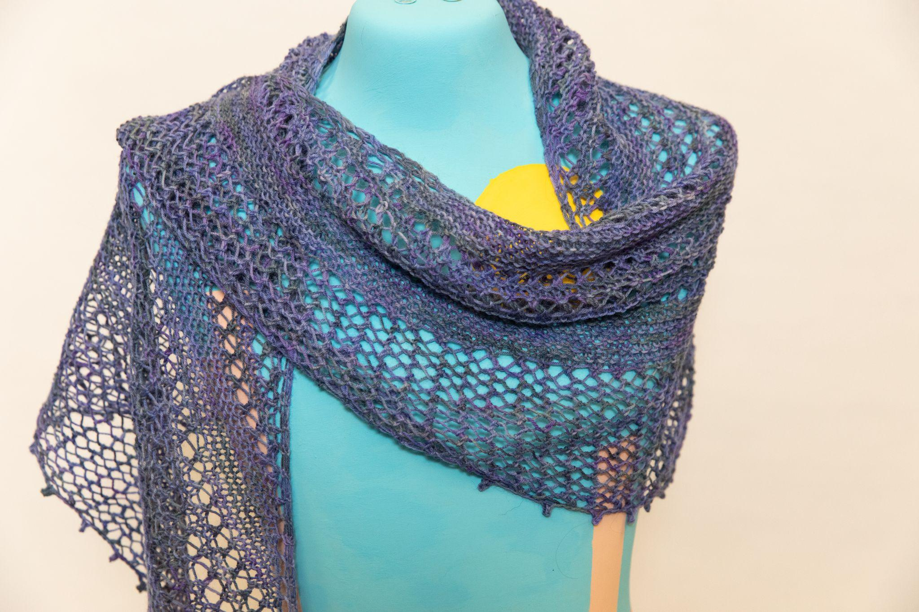
Gossamer Shawl by Laura Weeks
Second Place
Yarn: Estelle Yarns Arequipa
https://ravelry.com/projects/purplemathmom/gossamer

Slide 33
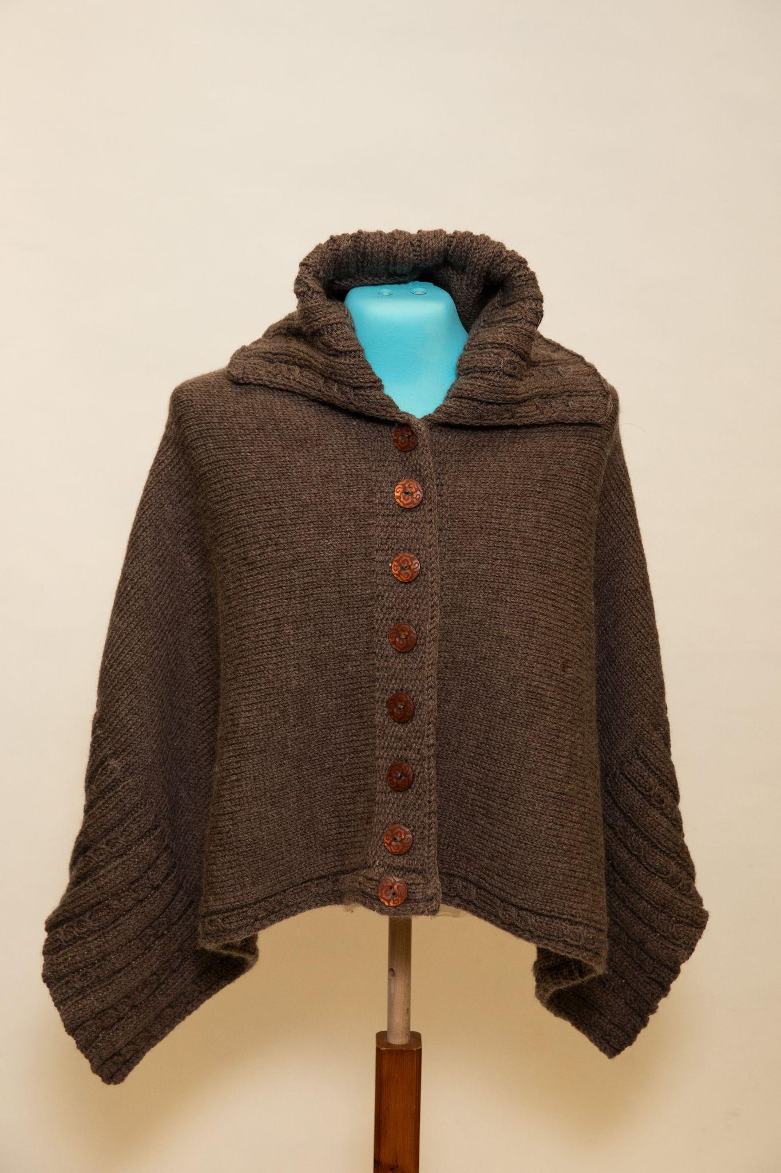
Bulky Poncho by Susan McLeod
Third Place
https://www.ravelry.com/patterns/library/miriam-carole-poncho

Slide 34
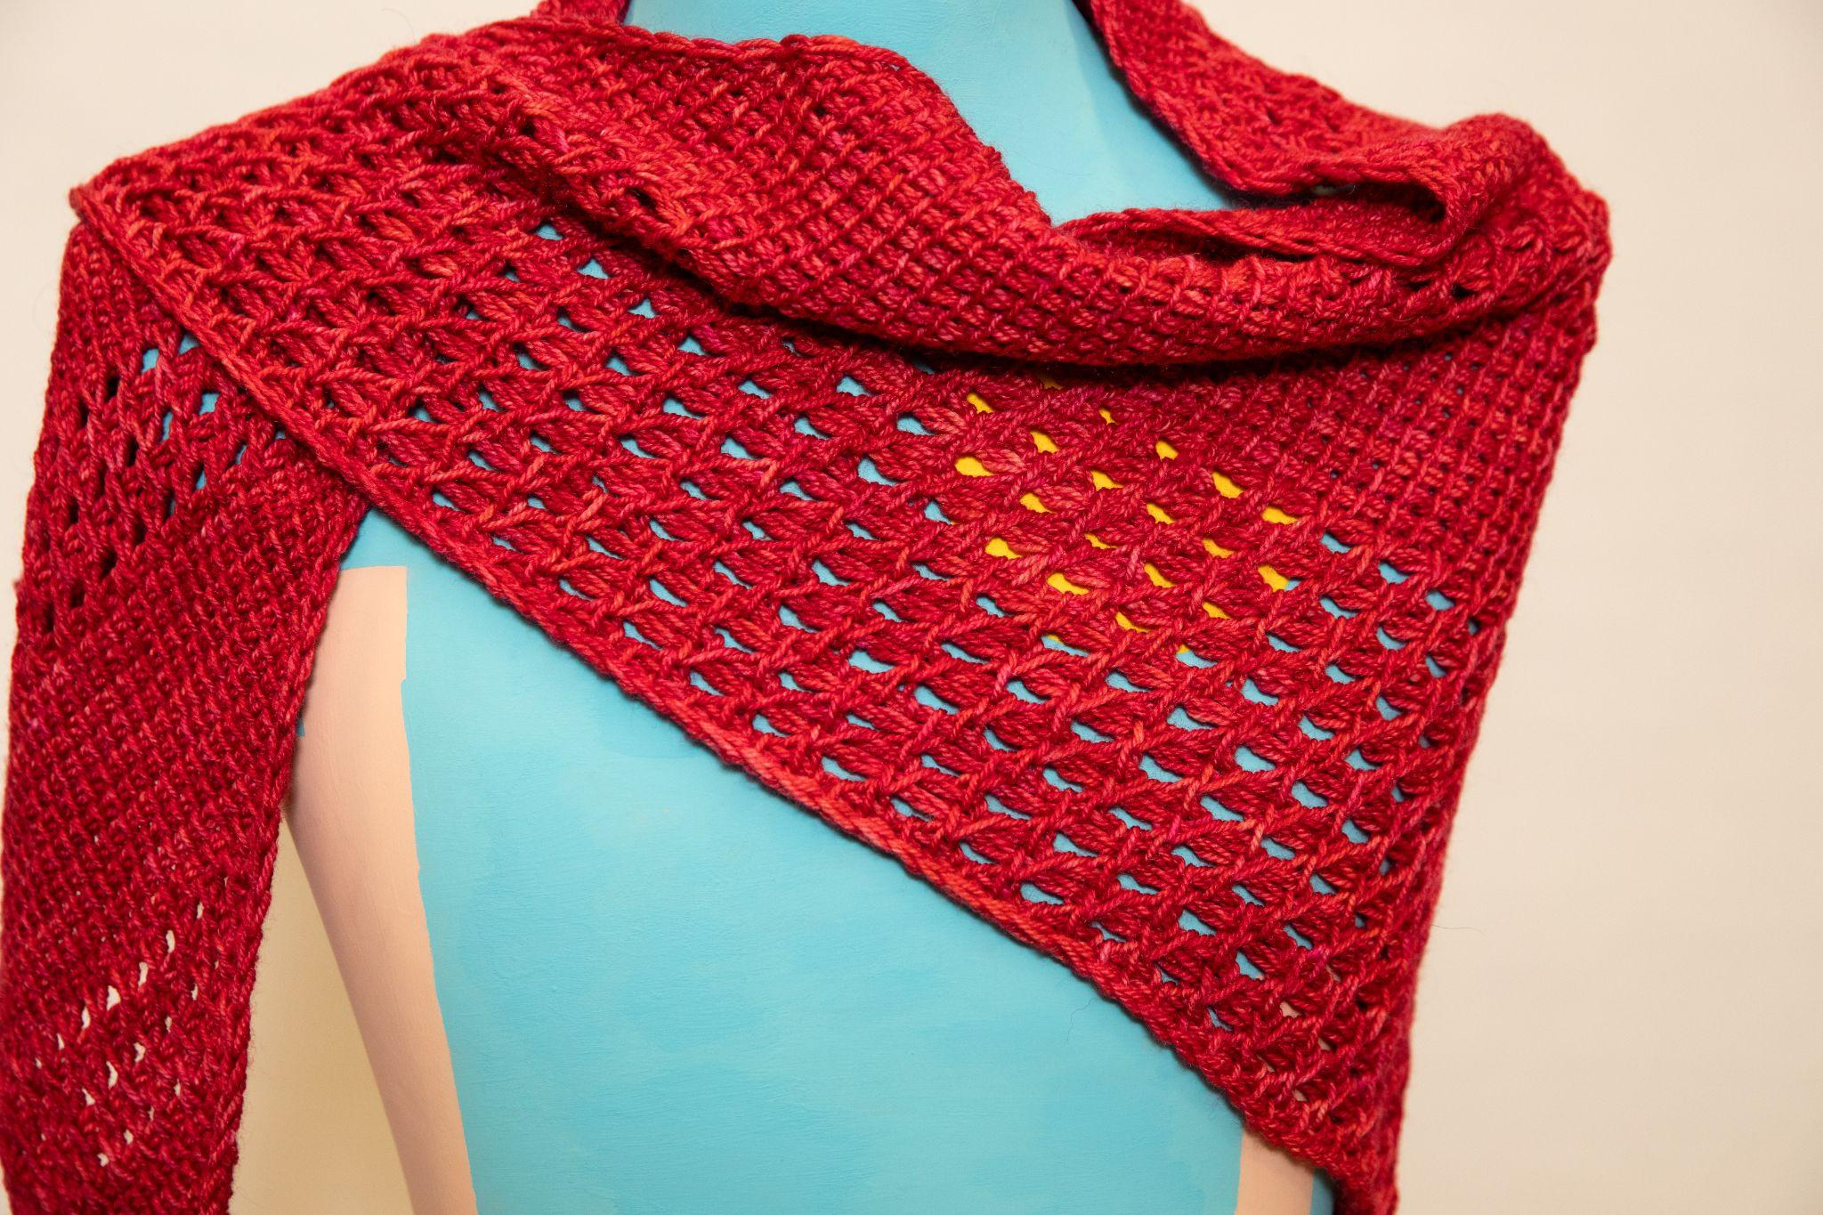
Tunisian Crochet Shawl by Anne Blayney
Yarn: Julie Asselin Leizu DK
https://www.ravelry.com/projects/AnnieBee/tunisian-quick-triangle-shawl

Slide 35
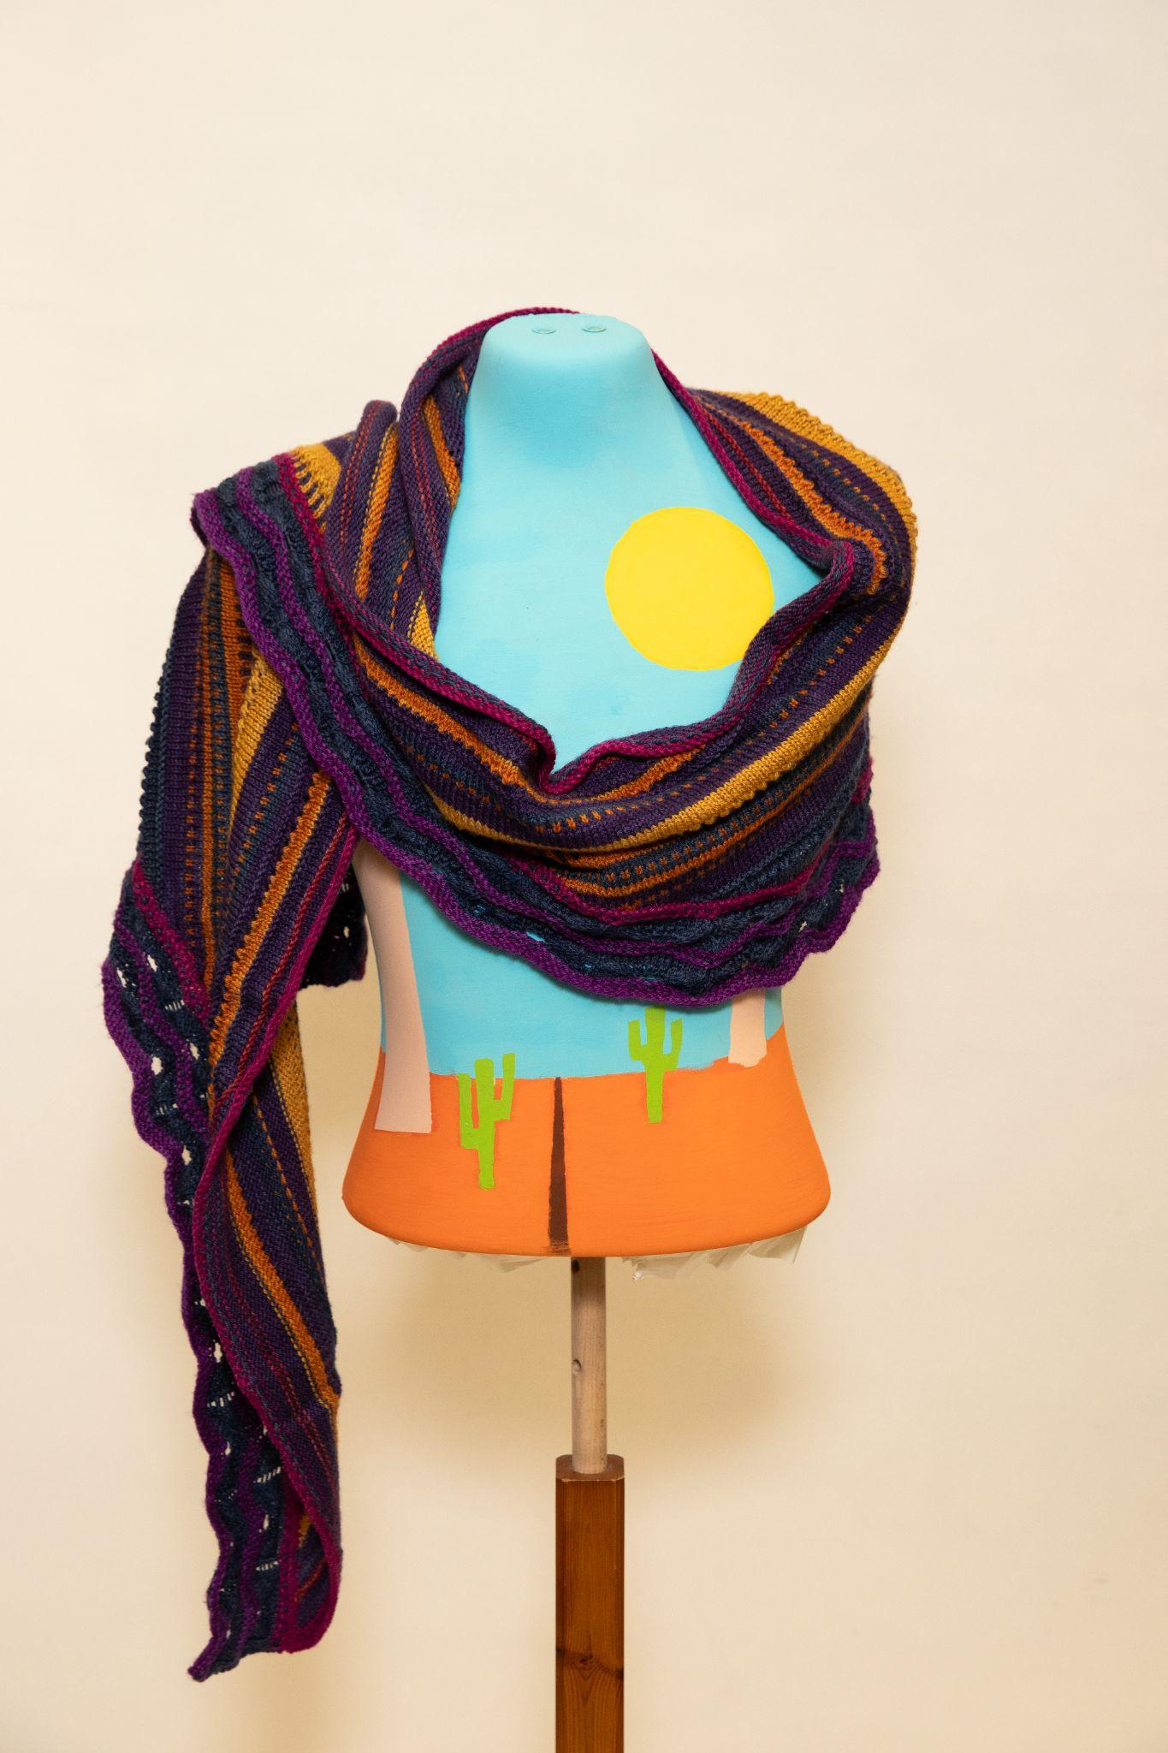
Quiet Bay Shawl by Dianne Littleton
Yarn: Sweet Georgia Tough Love Sock
https://www.ravelry.com/patterns/library/quiet-bay

Slide 36
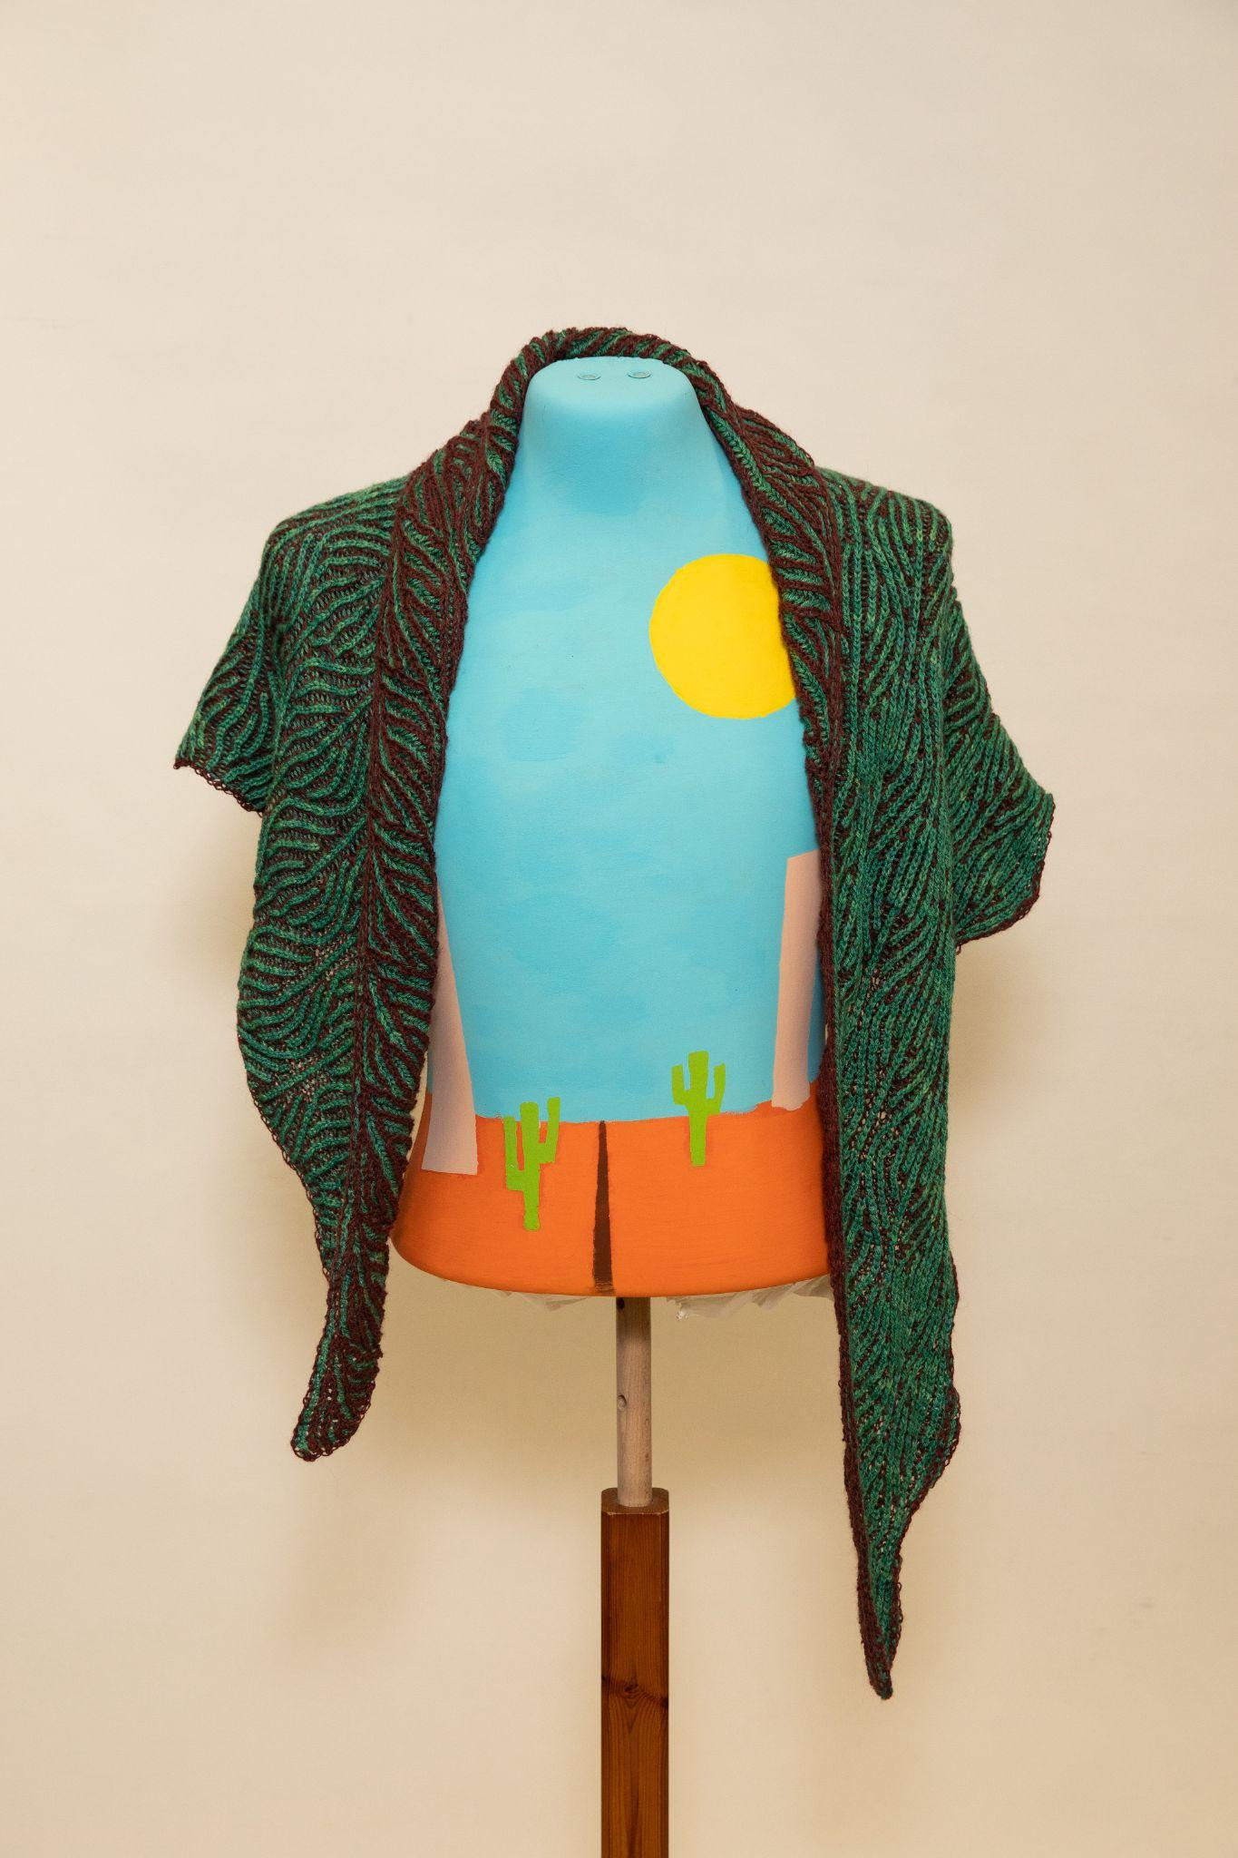
Brioche Tourist Shawl by Jenn Dellow
Yarn: Lofty Fibres Laceweight and Lorna’s Laces Alpaca Lace
https://www.ravelry.com/projects/jkdellow/the-tourist-shawl

Slide 37
Category 2: Shoulders
Main Course

Slide 38
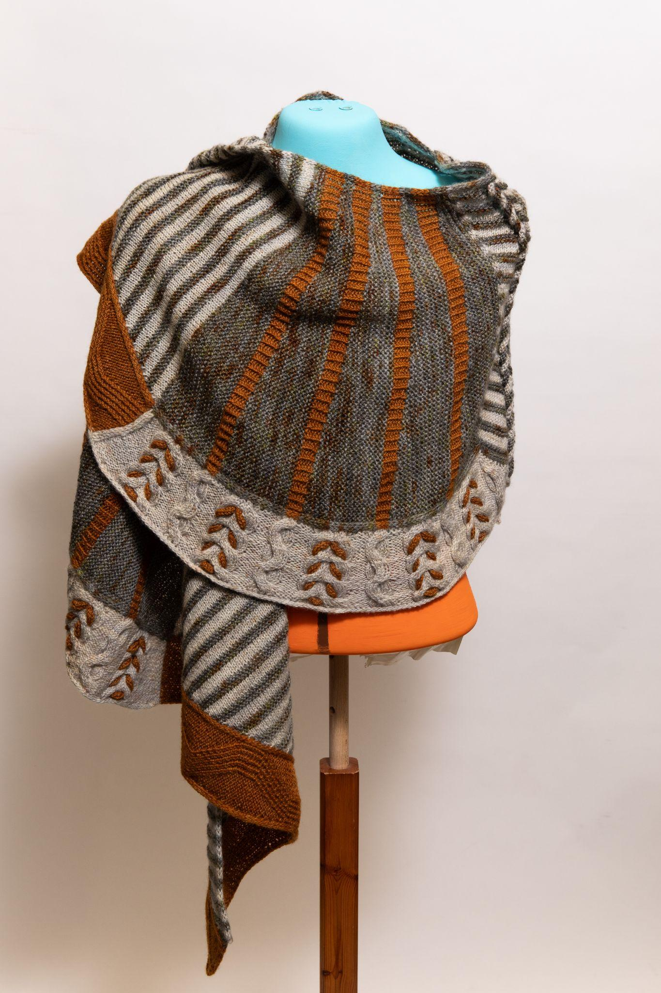
Twists & Turns Shawl by Susan Hoskins
First Place
Yarn: Akara BFL
https://www.ravelry.com/patterns/library/twists--turns-westknits-mkal-2022

Slide 39
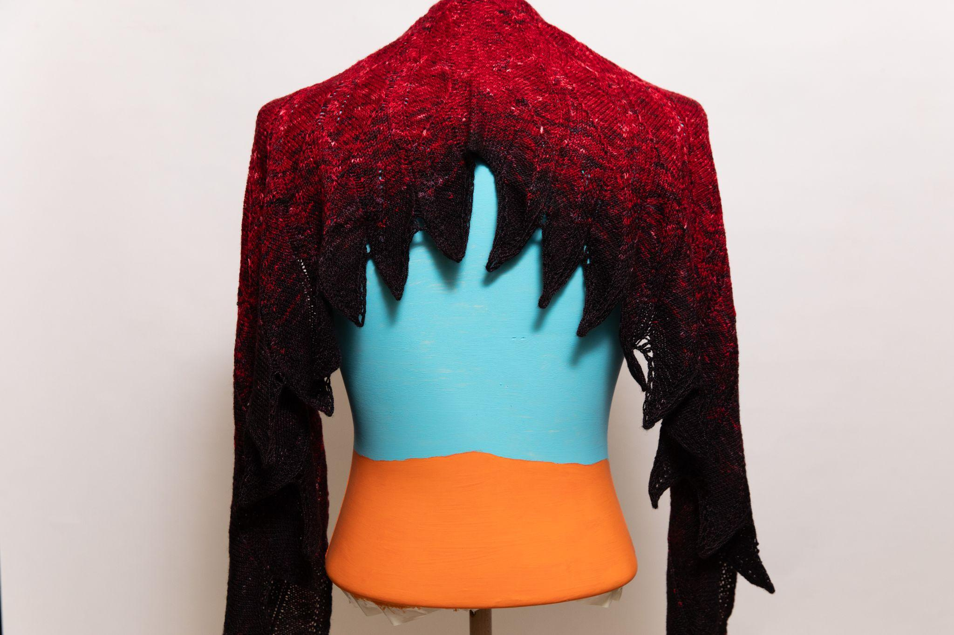
Wingspan Shawl by Lina Forner
Second Place
Yarn: coriand3r Merino Silk gradient
https://www.ravelry.com/projects/SocksyLady/wingspan

Slide 40
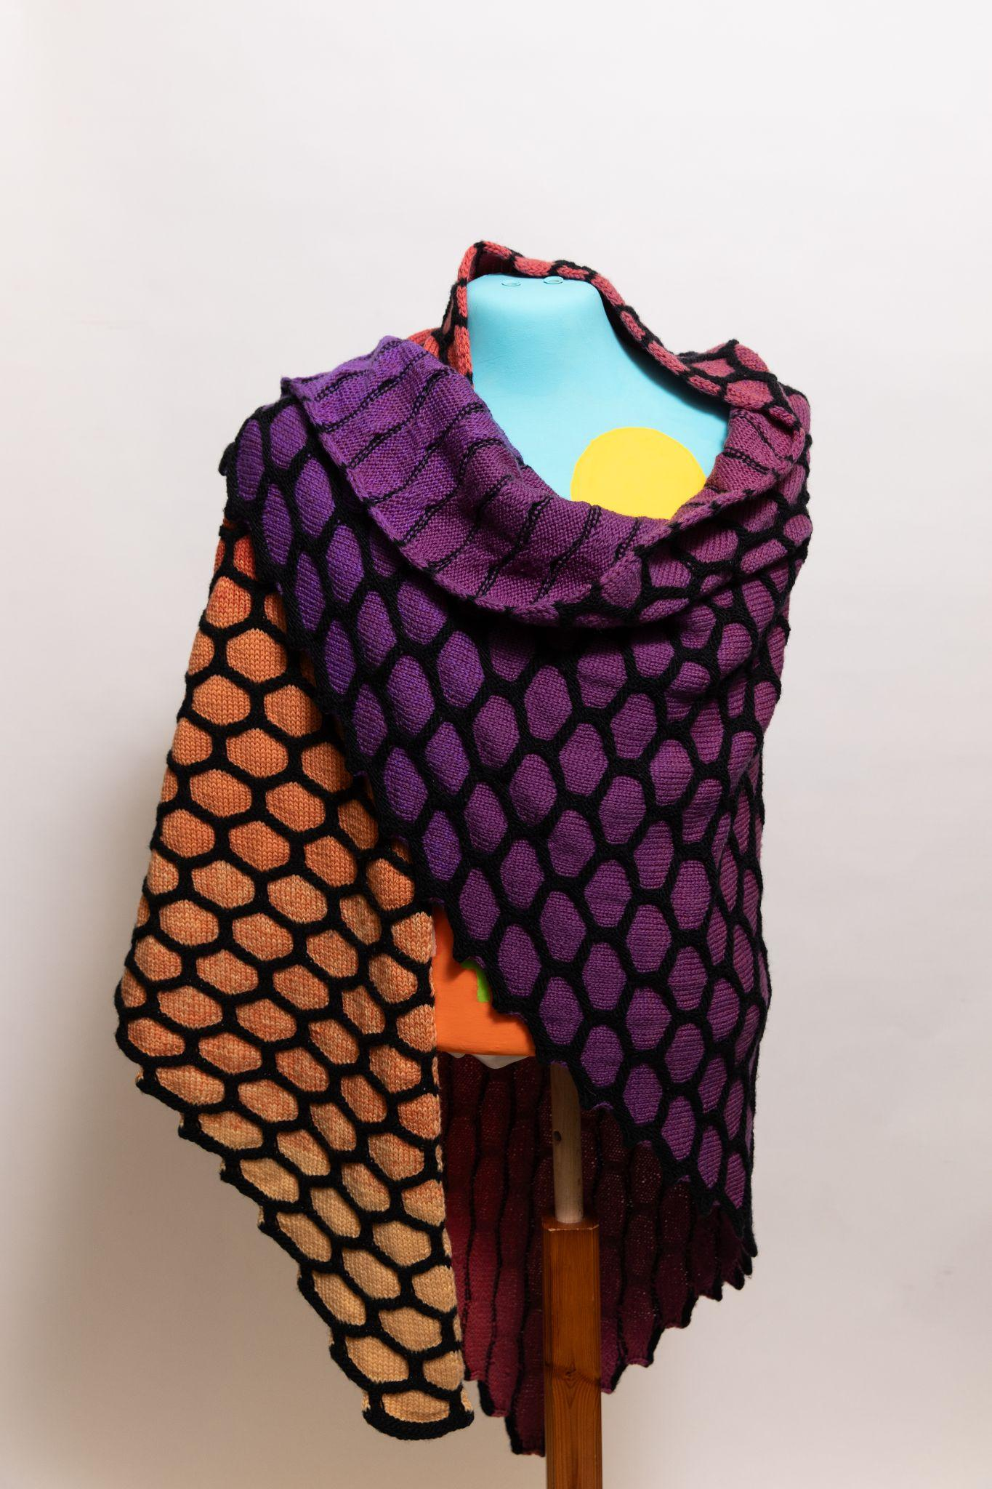
Painting Honeycombs Shawl by Lina Forner
Third Place
Yarn: Strickwear Merging Colors and Zitron Filigran
https://www.ravelry.com/projects/SocksyLady/painting-honeycombs-shawl---big-honeycombs

Slide 41
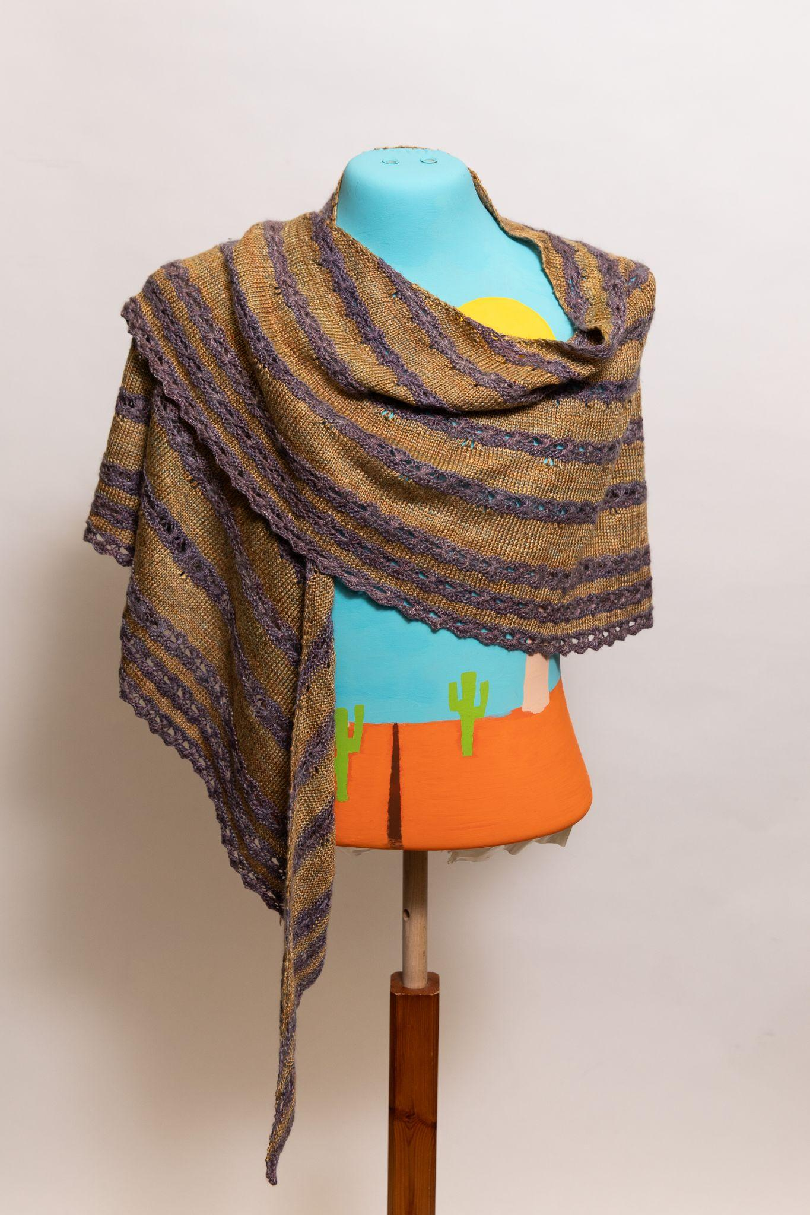
Blutenmeer Shawl by Lina Forner
Fourth Place
Yarn: Handspun yarn made with Sericin Silkworks silk fibre
https://www.ravelry.com/projects/SocksyLady/blutenmeer---sea-of-blossom

Slide 42
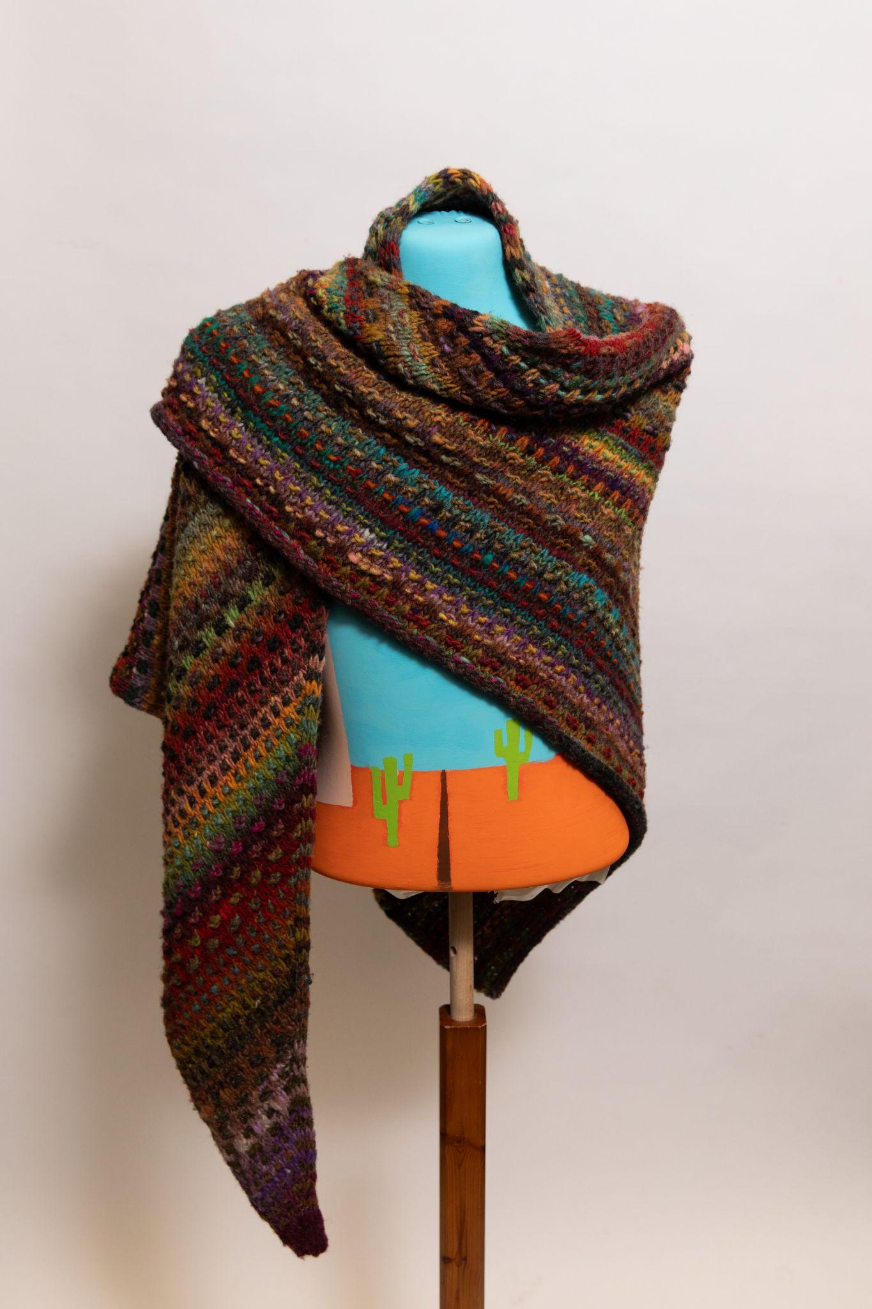
NightShade Shawl by Miriam Heynen
Fifth Place
Yarn: Noro Ito
https://www.ravelry.com/projects/CanadianKnitizen/nightshift-2

Slide 43
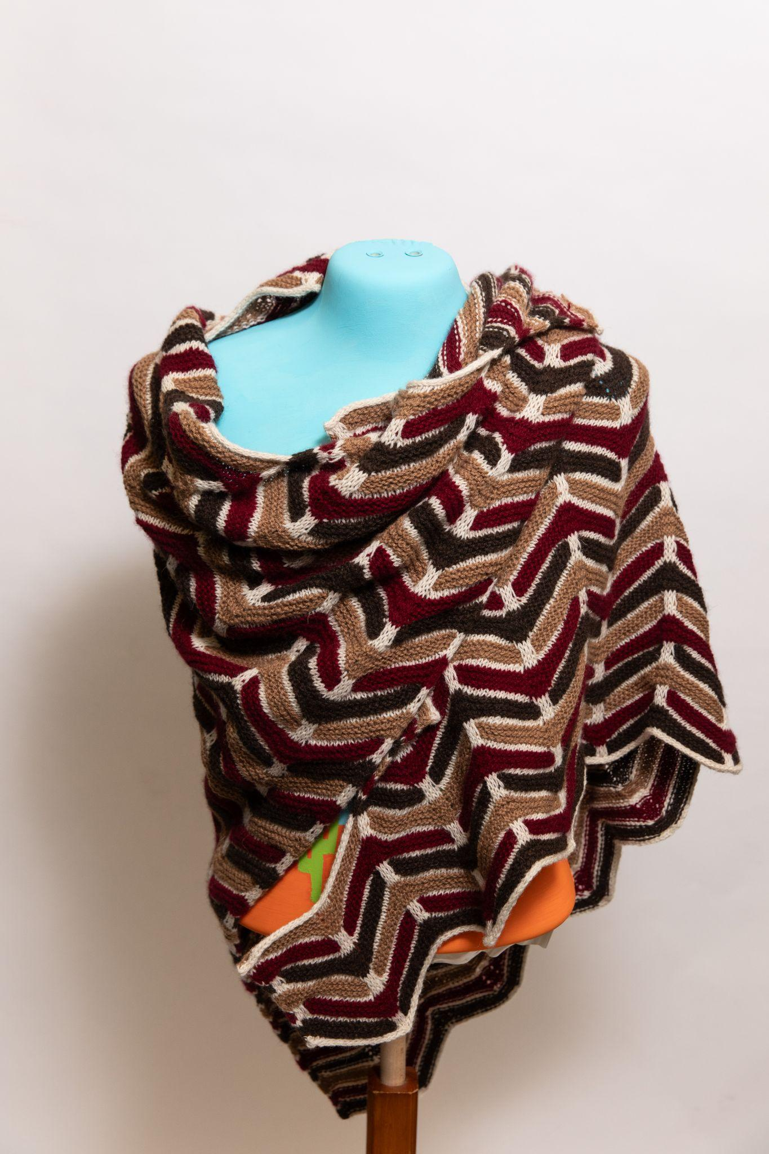
Woven Chevrons Shawl by Brooke Southgate
Sixth Place
Yarn: ULA + LIA
https://www.ravelry.com/patterns/library/woven-chevrons

Slide 44
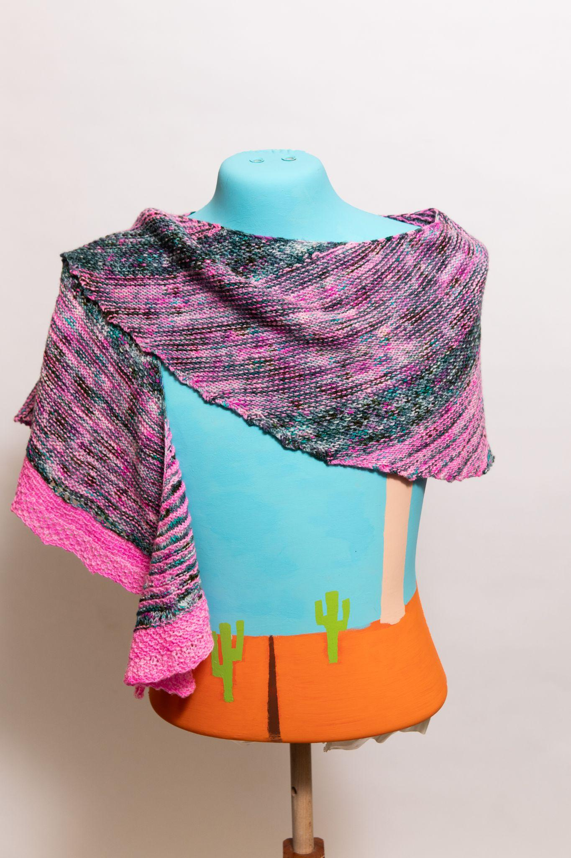
Hugshot Shawl by Brooke Southgate
https://www.ravelry.com/patterns/library/hug-shot

Slide 45
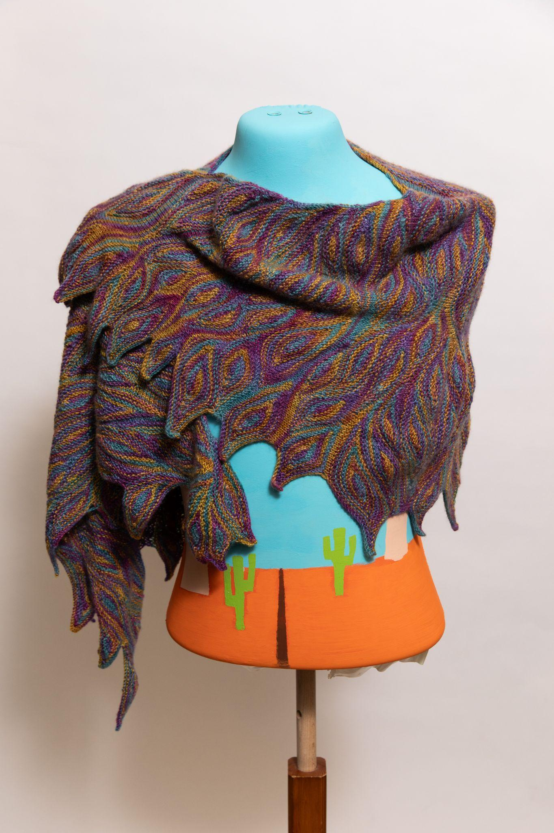
Impervious Shawl by Johanna Botari
Yarn: indigodragonfly Giftapalooza kit
https://www.ravelry.com/projects/johannab/impervious

Slide 46
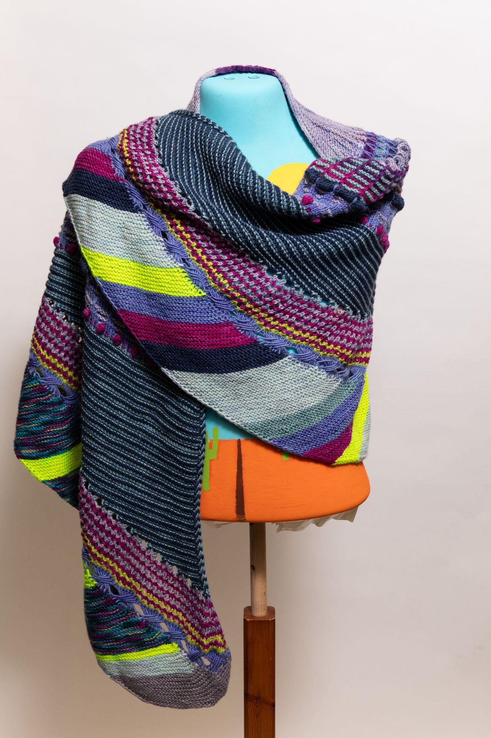
Shawlography Shawl by Johanna Botari
Yarn: Blue Moon Fibre Arts fingering
https://www.ravelry.com/projects/johannab/shawlography-westknits-mkal-2021

Slide 47
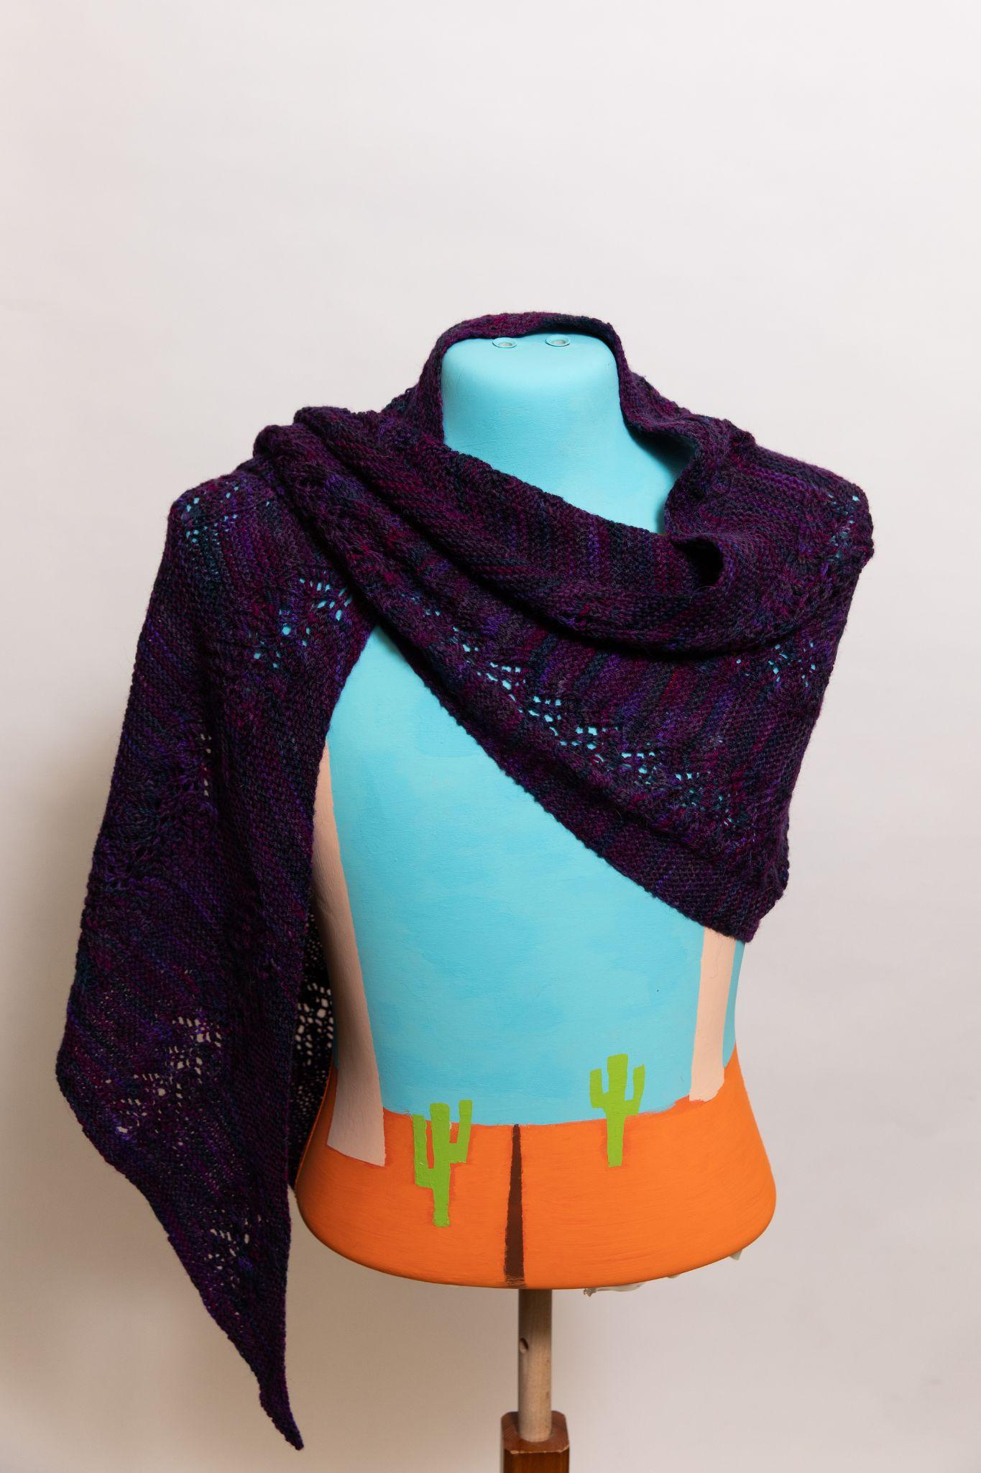
Crossflower Shawl by Laura Weeks
Yarn: Estelle Yarns Arequipa
https://ravelry.com/projects/purplemathmom/crossflower-shawl

Slide 48
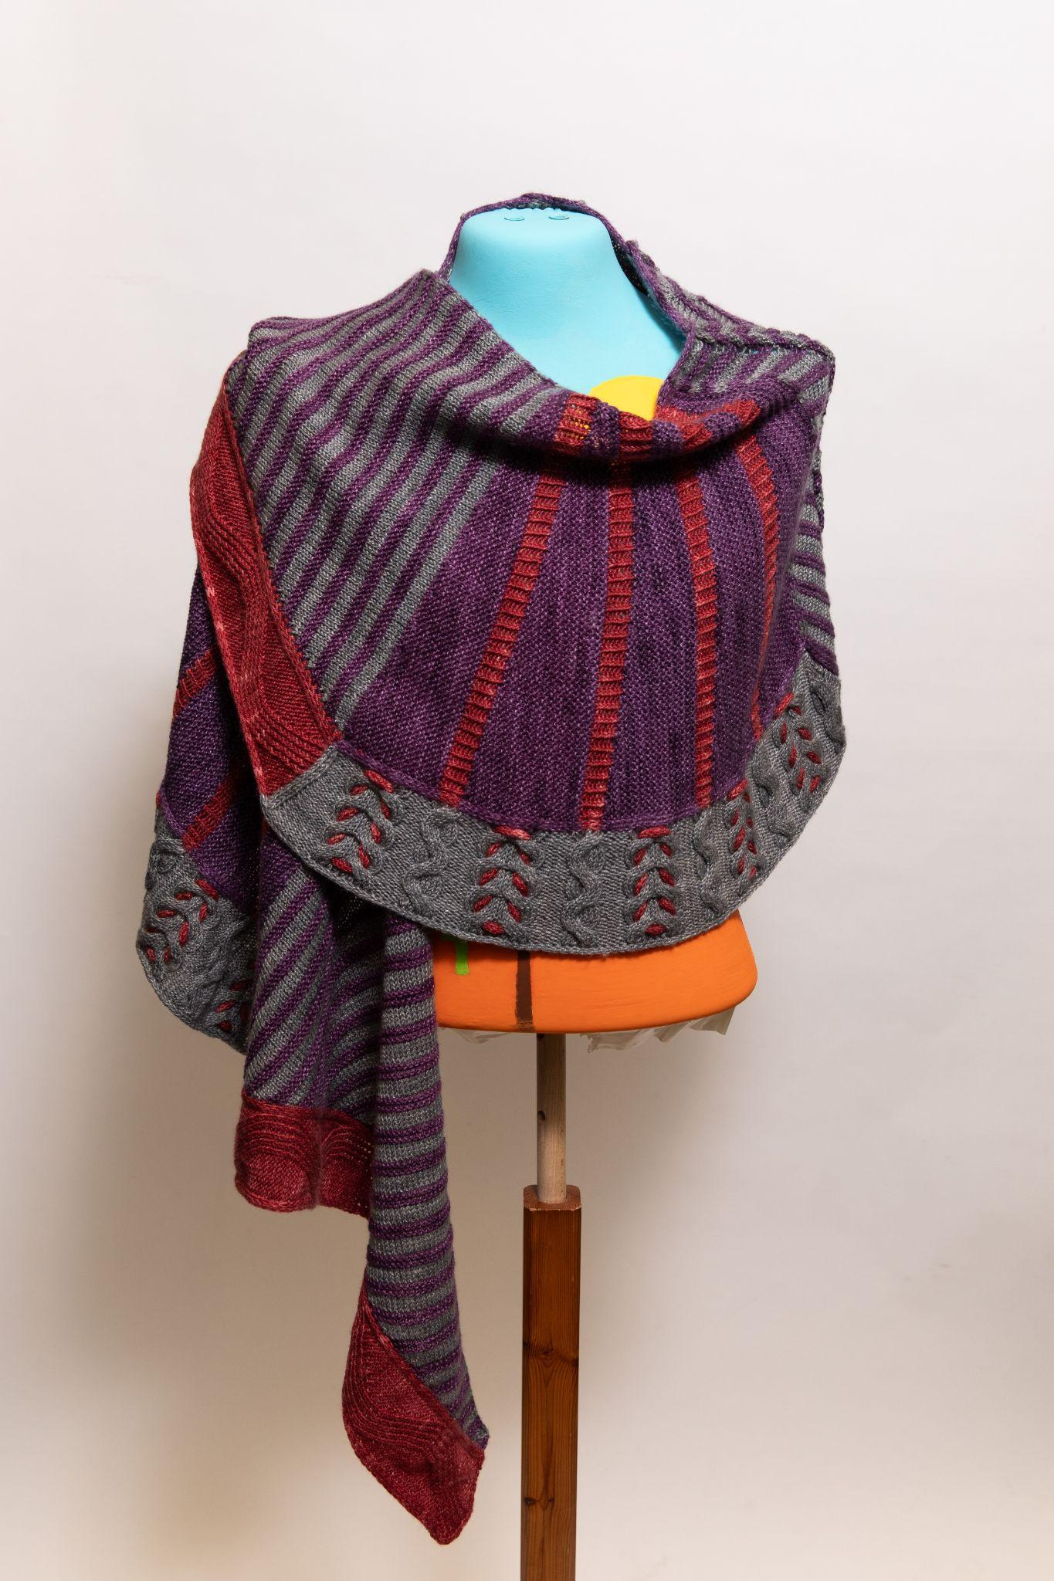
Twists & Turns Shawl by Lina Forner
Yarn: indigodragonfly Chameleon Sock
https://www.ravelry.com/projects/SocksyLady/twists--turns-westknits-mkal-2022

Slide 49
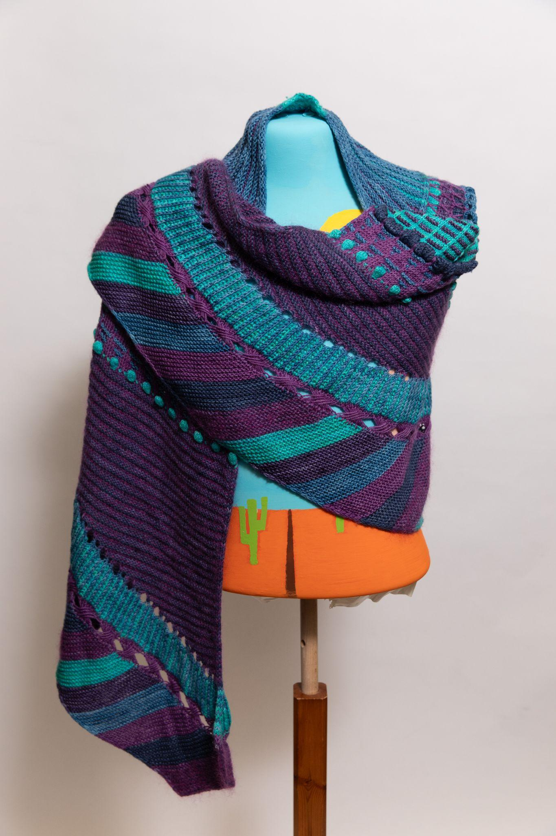
Shawlography Shawl by Lina Forner
Yarn: indigodragonfly CaribouBaa, indigodragonfly Tough Lester Sock, indigodragonfly Merino Sock, Rowan Kidsilk Creation, Sweet Georgia Tough Love Sock, and Whimsical Colors Silk Whimsy Lace
https://www.ravelry.com/projects/SocksyLady/shawlography-westknits-mkal-2021

Slide 50
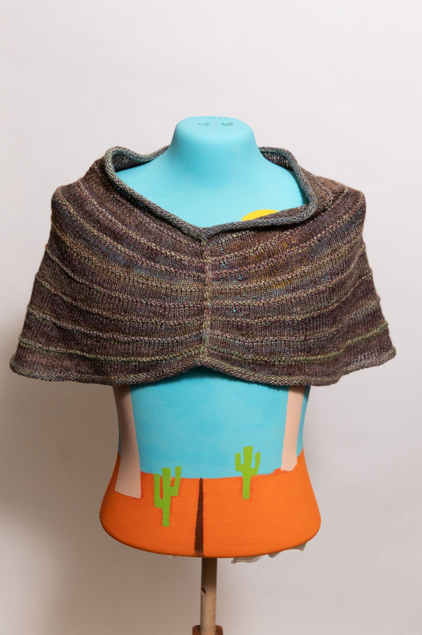
Across the Waters Shawl by Lina Forner
Yarn: Handspun yarn made with Sericin Silkworks silk, camel, and yak fibres
https://www.ravelry.com/projects/SocksyLady/across-the-waters

Slide 51
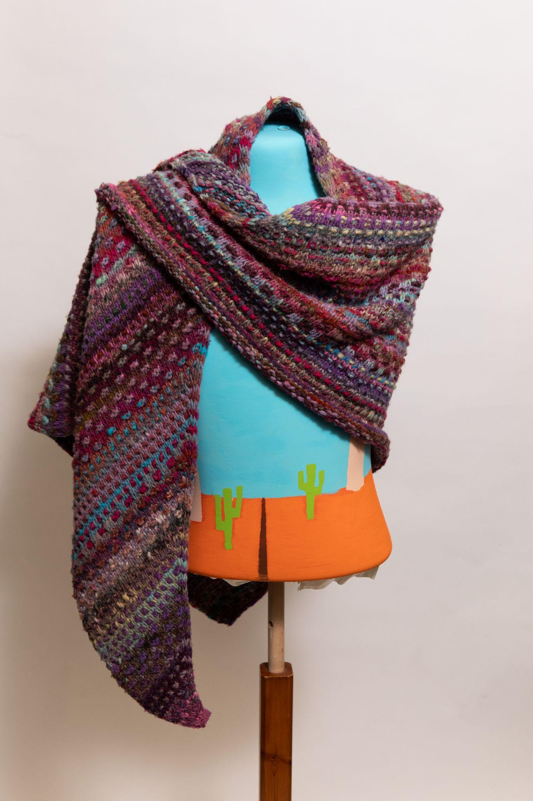
NightShade Shawl by Miriam Heynen
Yarn: Noro Ito
https://www.ravelry.com/projects/CanadianKnitizen/nightshift

Slide 52
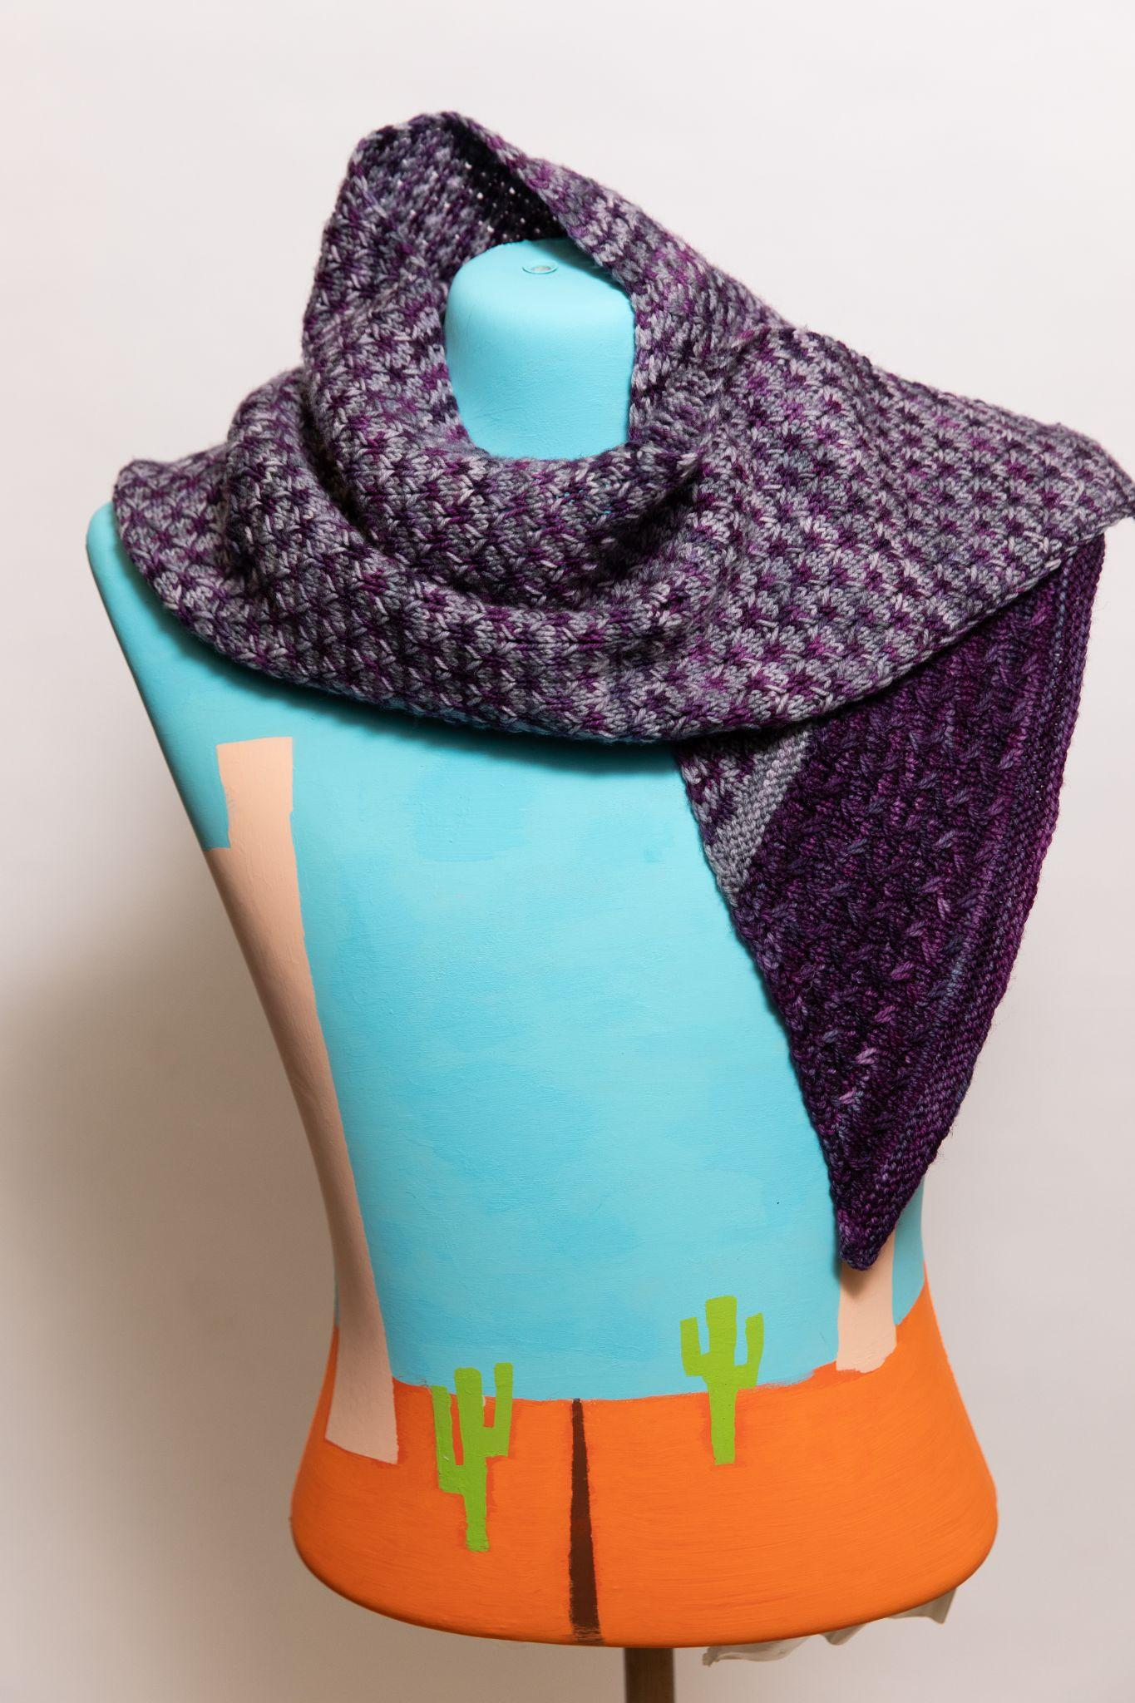
Lavender Lake Shawl by Rosemary Kohler
Yarn: Ancient Arts Socknado
https://www.ravelry.com/projects/goldenrex/lavender-lake

Slide 53
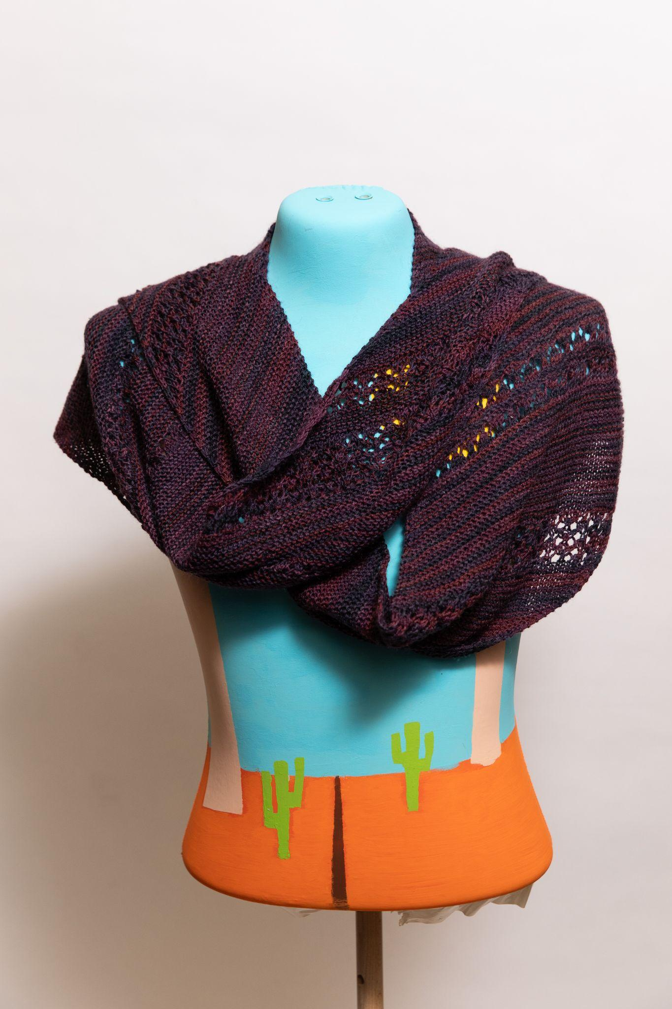
Carr Shawl by Susan Hoskins
Yarn: Silk
https://www.ravelry.com/patterns/library/carr

Slide 54
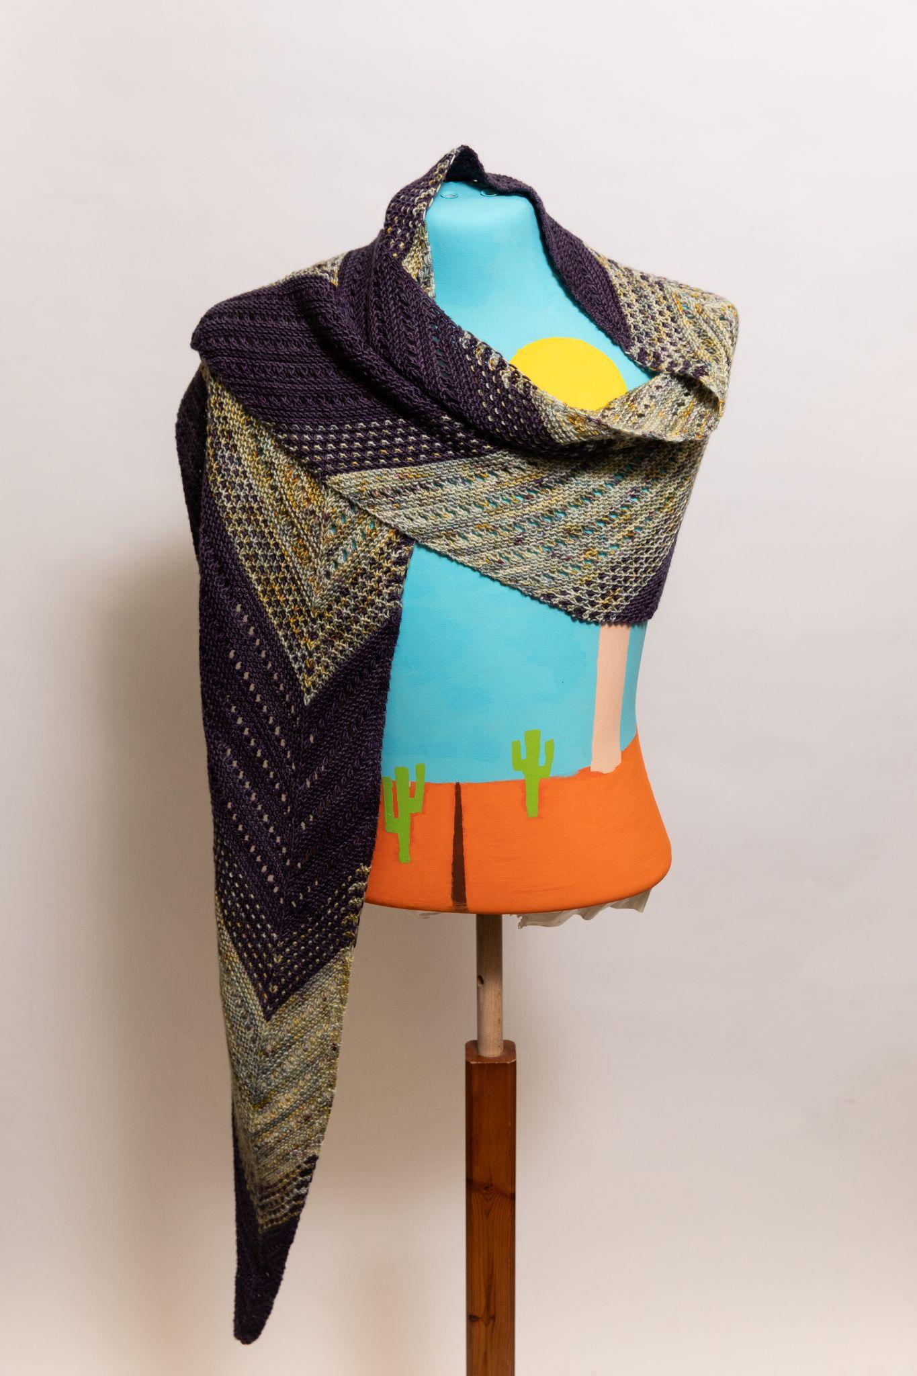
Zarya Shawl by Susan Hoskins
Yarn: Blue Mountain Fibre
https://www.ravelry.com/patterns/library/zarya-shawl

Slide 55
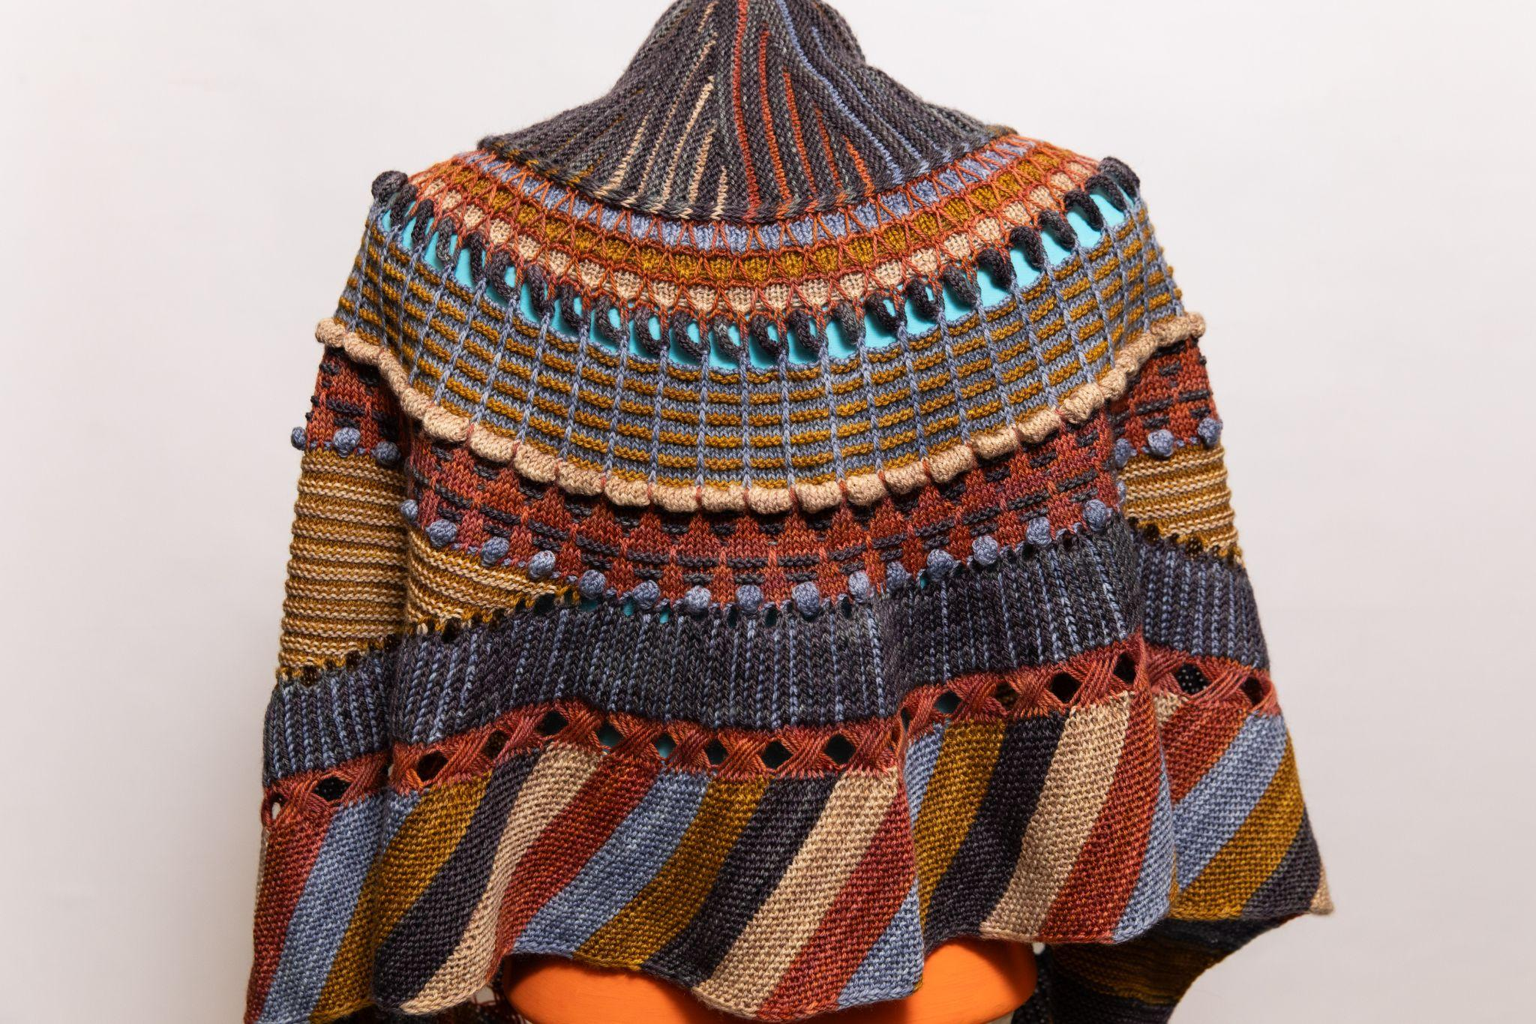
Shawlography Shawl by Susan Hoskins
https://www.ravelry.com/patterns/library/shawlography-westknits-mkal-2021

Slide 56
Painting Honeycombs Shawl by Susan Hoskins
Yarn: Biches et Buches Le Petit Lambswool
https://www.ravelry.com/patterns/library/painting-honeycombs-shawl---small-honeycombs

Slide 57
Bonjour Hi Capelet by Susan Simanzik
Yarn: Lil’ Red Kettlehead Aura and Fine Foot BFL
https://www.ravelry.com/patterns/library/bonjour-hi

Slide 58
Category 2: Shoulders
Dessert

Slide 59
Lace Wedding Shawl by Michael Plauntz
First Place
Yarn: Hand spun silk

Slide 60
Fragmented Wrap by Mary Martin
Second Place
Yarn: Malabrigo Silkpaca
https://www.ravelry.com/projects/MaryWMartin/fragmented-cowl-4

Slide 61
Painting Honeycombs Shawl by Michael Plauntz
Third Place
https://www.ravelry.com/patterns/library/painting-honeycombs-shawl---small-honeycombs

Slide 62
Radialactive Shawl by Cheryl McLeod
Yarn: indigodragonfly Chameleon Sock and Blue Brick Point Pelee Merino Lace
https://www.ravelry.com/projects/Cheryl21/radialactive

Slide 63
Beaded Lace Shawl by Katherine Matthews
Yarn: Handspun lace
Social Recognition Award

Slide 64
Unicorn Stripes Wrap by Lynn Philips
Yarn: Garnstudio DROPS, Les Laines Coco Bas du Fleuve, Les Laines Coco Mini Fee, Mrs Crosby Train Case, Red Heart Heart & Sole, Schachenmeyr Baby Smiles, St-Denis Boreale, and Tanis Fibre Arts Blue Label
https://ravelry.com/projects/needler60/unicorn-stripes-wrap

Slide 65
Payoff Shawl by Lynne Sosnowski
https://www.ravelry.com/patterns/library/payoff
Social Recognition Award

Slide 66
Mosaic Shawl by Michael Plauntz

Slide 67
Mohair Quiet Bay Shawl by Michael Plauntz
https://www.ravelry.com/patterns/library/quiet-bay

Slide 68
Twists & Turns Shawl by Michael Plauntz
https://www.ravelry.com/patterns/library/twists--turns-westknits-mkal-2022

Slide 69
Wingspan Shawl by Michael Plauntz
Yarn: Blue Brick ombre
https://www.ravelry.com/patterns/library/wingspan-3

Slide 70
Category 3: Knees & Body
Appetizers (Firsts)

Slide 71
Brioche Pullover by Miriam Heynen
First Place
Yarn: Skacel Kenzie HiKoo and The Fibre Co Cumbria
https://www.ravelry.com/projects/CanadianKnitizen/mariekes-pullover

Slide 72
Manzanita Sweater by Jenn Dellow
Second Place
Yarn: indigodragonfly OctoBaa
https://www.ravelry.com/projects/jkdellow/manzanita-tee

Slide 73
Self-Designed Yoke Sweater by Dianne Littleton
Yarn: Sweet Georgia Tough Love Sock

Slide 74
Streamline Tank by Dianne Littleton
https://www.ravelry.com/patterns/library/streamline-tank

Slide 75
Kore Cable Cardigan by Dianne Littleton
Yarn: Patons Classic Wool Worsted
https://www.ravelry.com/patterns/library/kore-cardi

Slide 76
Vivi Cable Pullover by Rosemary Kohler
Yarn: Cascade 220 Superwash
https://www.ravelry.com/projects/goldenrex/vivi

Slide 77
Category 3: Knees & Body
Main Course: Cardigans

Slide 78
Fair Isle Cardigan by Barbara Kerr
First Place

Slide 79
Mastiha Cable Cardigan by Susan Hoskins
Second Place
Yarn: Patons
https://www.ravelry.com/patterns/library/mastiha

Slide 80
Cabin Cardi by Miriam Heynen
Third Place
Yarn: Cascade Heritage Sock
https://www.ravelry.com/projects/CanadianKnitizen/cabin-cardi-and-hat

Slide 81
Endorphins Sweater by Betty Bax
Yarn: indigodragonfly CaribouBaa
https://www.ravelry.com/patterns/library/endorphins

Slide 82
Camelia Pinecone Cardigan by Debbie Bolt
Yarn: Indiecita DK Luxurious Baby Alpaca
https://www.ravelry.com/projects/dbtinksalot/camelia

Slide 83
Hudson Bay Cardigan by Miriam Heynen
Yarn: Cascade Anchor Bay
https://www.ravelry.com/projects/CanadianKnitizen/pepper-7

Slide 84
Category 3: Knees & Body
Main Course: Pullovers

Slide 85
Dog Star Pullover by Barbara Kerr
First Place
Yarn: Tuku DK
https://www.ravelry.com/patterns/library/dog-star

Slide 86
Rural Symphony Pullover by Amanda Mustard
Second Place
Yarn: Honer och Eir Nutiden
https://www.ravelry.com/projects/AmandaDianeM/rural-symphony-pullover

Slide 87
Parker Head Turtleneck by Lina Forner
Third Place
Yarn: indigodragonfly Wingenhooven DK
https://www.ravelry.com/projects/SocksyLady/parker-head

Slide 88
Lace Yoke Top by Lorna Morris
Fourth Place
Yarn: Koigu KPPPM
https://www.ravelry.com/patterns/library/kevat-4

Slide 89
Gradient Top by Lina Forner
Fifth Place
Yarn: Jo Sharpe Alpaca Silk Georgette
https://www.ravelry.com/projects/SocksyLady/gradient-top

Slide 90
Red Sunday Sweater by Betty Bax
Sixth Place

Slide 91
Autumn Armour Sweater by Amanda Mustard
Yarn: Explorer Denali Sock
https://www.ravelry.com/projects/AmandaDianeM/elfmail

Slide 92
Cable Sweater by Betty Bax
Yarn: Berroco

Slide 93
Matching Cat Sweaters by Betty Bax
Social Recognition Award

Slide 94
V-Back Tee by Dianne Littleton
https://www.ravelry.com/patterns/library/the-v-back-tee-fingering

Slide 95
Summer McVie Sweater by Jenn Dellow
Yarn: Holst Garn Coast Uld Bomuld
https://www.ravelry.com/projects/jkdellow/mcvie

Slide 96
Hidden Ridge Sweater by Lina Forner
Yarn: Adrienne Vittadini Donata
https://www.ravelry.com/projects/SocksyLady/hidden-ridge

Slide 97
Atlantique Vest by Lina Forner
Yarn: indigodragonfly Half & Half Sock
https://www.ravelry.com/projects/SocksyLady/atlantique

Slide 98
Idril Top by Lina Forner
Yarn: indigodragonfly Chameleon Sock
https://www.ravelry.com/projects/SocksyLady/idril

Slide 99
Linen Top by Lorna Morris

Slide 100
Miala Sweater by Miriam Heynen
Yarn: Berroco Blackstone Tweed and StahlSche Wolle Alcampa
https://www.ravelry.com/projects/CanadianKnitizen/miala

Slide 101
Peacock Sweater by Miriam Heynen
Yarn: Knit Picks Aloft and Koigu Kersti Merino Crepe
https://www.ravelry.com/projects/CanadianKnitizen/peacock-sweater-solo

Slide 102
Finally Schneeflocken Sweater by Miriam Heynen
Yarn: Estelle Yarns Eco Tweed DK
https://www.ravelry.com/projects/CanadianKnitizen/finally

Slide 103
Ranunculus Sweater by Miriam Heynen
Yarn: Holst Supersoft, Leo & Roxy 80/20 Sock, and Leo & Roxy Mohair Silk
https://www.ravelry.com/projects/CanadianKnitizen/ranunculus
Social Recognition Award

Slide 104
Lilah Pullover by Susan McLeod
https://www.ravelry.com/patterns/library/lilah-pullover

Slide 105
Ranunculus Sweater by Susan Simanzik
Yarn: Juniper Moon Patagonia Organic Merino
https://www.ravelry.com/patterns/library/ranunculus-3

Slide 106
Category 3: Knees & Body
Dessert

Slide 107
Please Do Not Adjust Your Skirt by Lynne Sosnowski
First Place
Yarn: Cascade 220
https://www.ravelry.com/patterns/library/please-do-not-adjust-your-skirt

Slide 108
Basic Skirt by Debbie Bolt
Second Place
Yarn: Needful Yarns Australian Merino
https://www.ravelry.com/projects/dbtinksalot/ann-budd-basic-skirt-class

Slide 109
Cable Dress by Cheryl McLeod
Third Place
Yarn: indigodragonfly MCS Sock
https://www.ravelry.com/projects/Cheryl21/customfit-8

Slide 110
Julissa Pullover by Amanda Mustard
Yarn: Knit Picks Swish Worsted
https://www.ravelry.com/projects/AmandaDianeM/julissa

Slide 111
Ink Sweater by Cheryl McLeod
Yarn: indigodragonly CaribouBaa
https://www.ravelry.com/projects/Cheryl21/ink

Slide 112
Mycroft Sweater by Victoria Lewin
Yarn: Twin Oaks Worsted
https://www.ravelry.com/projects/vrock/mycroft

Slide 113
Beauty School Sweater by Victoria Lewin
Yarn: Emelia & Philomene Josephine
https://www.ravelry.com/projects/vrock/beauty-school

Slide 114
Category 4: Toes & Fingers
Main Course

Slide 115
Purple Converse Slippers by Betty Bax
First Place
Yarn: Berroco Vintage
https://www.ravelry.com/patterns/library/reaverse-star-edition

Slide 116
Diagonal Socks by Laura Weeks
Second Place
https://ravelry.com/projects/purplemathmom/in-the-diagonal-2

Slide 117
Fair Isle Mittens by Linda Baird
Third Place

Slide 118
Phiolet Fingerless Gloves by Jenn Dellow
Yarn: Shelridge 80/20 Fingering, Leo & Roxy 80/20 Sock, and Lichen and Lace 80/20 Sock
https://www.ravelry.com/projects/jkdellow/phiolet

Slide 119
Flap Mittens by Laura Weeks
Yarn: Estelle Yarns Worsted
https://ravelry.com/projects/purplemathmom/mittens-with-a-flap

Slide 120
Spruce Mittens by Miriam Heynen
Yarn: Patons North America Classic Wool Merino
https://www.ravelry.com/projects/CanadianKnitizen/spruce-mittens

Slide 121
Gro Mitts by Miriam Heynen
Yarn: Holst Garn Supersoft
https://www.ravelry.com/projects/CanadianKnitizen/the-worlds-simplest-mittens-2

Slide 122
Category 4: Toes & Fingers
Dessert

Slide 123
2022 Fair Isle Mittens by Victoria Lewin
First Place
Yarn: Sandnes Garn Sisu
https://www.ravelry.com/projects/vrock/womens-mitten-from-the-norwegian-museum-of-cultural-history

Slide 124
Peregrinate Socks by Cheryl McLeod
Second Place
Yarn: indigodragonfly CaribouBaa
https://www.ravelry.com/projects/Cheryl21/peregrinate

Slide 125
Lace Socks by Karen Ireland
Third Place

Slide 126
Rock and Sea Socks by Johanna Botari
Yarn: Blue Moon Fibre Arts Socks that Rock Mediumweight
https://www.ravelry.com/projects/johannab/rock-and-weave

Slide 127
Fair Isle Mittens by Karen Ireland

Slide 128
Basic Socks by Karen Ireland

Slide 129
Kirkmichael Mittens by Karen Ireland
https://www.ravelry.com/patterns/library/kirkmichael

Slide 130
Red Sequined Converse Slippers by Karen Ireland
https://www.ravelry.com/patterns/library/reaverse-star-edition

Slide 131
UnderHand Gloves by Lynne Sosnowski
Yarn: Naturally Yarns NZ Amuri
https://www.ravelry.com/patterns/library/underhand

Slide 132
Category 5: Home
Appetizers

Slide 133
Holiday Baubles Blanket by Dianne Littleton
First Place
https://www.ravelry.com/patterns/library/holiday-baubles-blanket-cal

Slide 134
Jupiter by Miriam Heynen
Second Place
Yarn: Ancient Arts Socknado
https://www.ravelry.com/projects/CanadianKnitizen/jupiter-for-nori

Slide 135
T-Rex by Karen Ireland
https://www.ravelry.com/patterns/library/t-rex-dinosaur-5

Slide 136
Little Tomte by Susan McLeod
Yarn: Lopi
https://www.ravelry.com/patterns/library/little-tomte

Slide 137
Category 5: Home
Main Course/Dessert

Slide 138
Mother Hen and Chicks by Karen Ireland
First Place
Yarn: Hen is leftover stash yarn, chicks are Rico Creative Bubble
https://www.alandart.co.uk/product/all-patterns/mother-hen-and-chicks/

Slide 139
Christmas Stockings by Victoria Lewin
Second Place
Yarn: Patons North America Classic Wool Worsted and Patons North America Classic Wool DK Superwash
https://www.ravelry.com/projects/vrock/holiday-stocking
https://www.ravelry.com/projects/vrock/snow-bird-stocking

Slide 140
Starflower Blanket by Cheryl McLeod
Third Place
Yarn: Leo & Roxy 80/20 Sock
https://www.ravelry.com/projects/Cheryl21/starflower-2

Slide 141
Bubbalub by Brooke Southgate
Fourth Place
Yarn: Worsted weight wool
https://www.ravelry.com/patterns/library/bubbalub

Slide 142
Frankston Market Bag by Brooke Southgate
Yarn: Bernat Handicrafter Cotton
https://www.ravelry.com/patterns/library/frankston-market-bag

Slide 143
Ophthalmosaurus by Brooke Southgate
Yarn: Worsted weight wool
https://www.ravelry.com/patterns/library/ophthalmosaurus-ichthyosaur

Slide 144
Dumpling Kitty by Brooke Southgate
Yarn: Patons Canadiana
https://www.ravelry.com/patterns/library/dumpling-kitty

Slide 145
Meowna Lisa by Brooke Southgate
Yarn: Patons Canadiana
https://www.ravelry.com/patterns/library/the-meow-na-lisa

Slide 146
Terror Bird by Brooke Southgate
https://www.ravelry.com/patterns/library/terror-bird

Slide 147
Blooming Baby Blanket by Mary Martin
Yarn: Miss Babs Yowza
https://www.ravelry.com/projects/MaryWMartin/blooming-baby-blanket

Slide 148
Santa Pillows by Miriam Heynen
Yarn: Berroco Vintage
https://www.ravelry.com/projects/CanadianKnitizen/reindeer-pillow-12

Slide 149
Mitred Blanket by Susan Simanzik
Yarn: Noro

Slide 150
Martha the Doll by Tasha Glover
https://www.ravelry.com/patterns/library/martha-20

Slide 151
Florence the Doll by Tasha Glover
https://www.ravelry.com/patterns/library/florence-35

Slide 152
Category 6: Multicraftual

Slide 153
Swatch Knitting Bag by Joan Gough
First Place
https://www.ravelry.com/projects/shinebrightest/swatch-inspired-reversible-knitting-bag

Slide 154
Dragon Baby Blanket by Miriam Heynen
Second Place
Yarn: Berroco Comfort
https://www.ravelry.com/projects/CanadianKnitizen/dragon-3

Slide 155
Rug Hook Knitters by Susan Simanzik
Third Place

Slide 156
Grainger Jacket by Anne Blayney
Yarn: Briggs & Little Heritage, Briggs & Little Regal, and handspun wool
https://www.ravelry.com/projects/AnnieBee/grainger-jacket

Slide 157
Braided Together Tote Bag and Cowl by Laura Weeks
Yarn: Bernat Softee Chunky
https://ravelry.com/projects/purplemathmom/braided-together-cowl

Slide 158
Baby Yoda (Grogu) by Lorna Morris
Yarn: Star Wars Crochet Kit
https://www.ravelry.com/patterns/library/yoda-8

Slide 159
Lyyli Project Bag by Susan McLeod
https://www.ravelry.com/patterns/library/lyyli-project-bag

